Slide 1
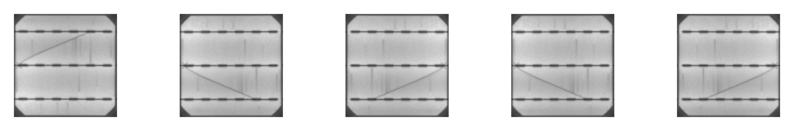
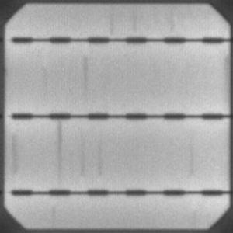
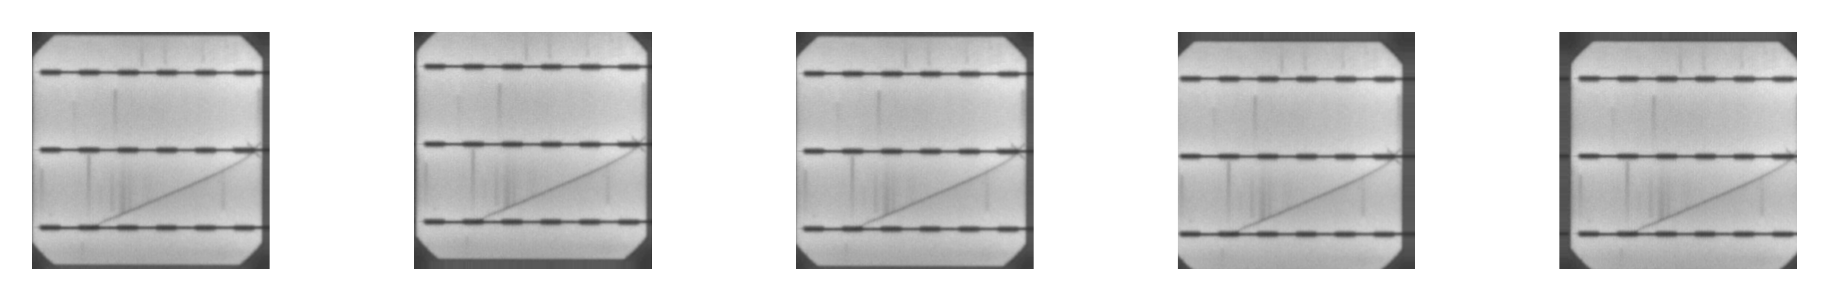
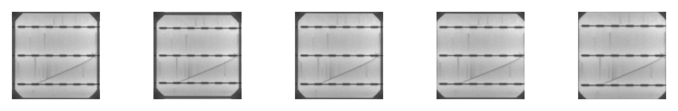
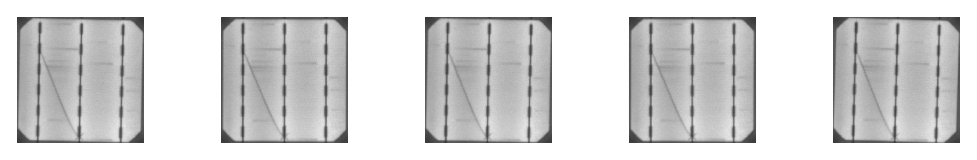
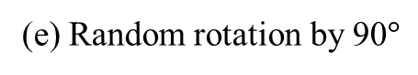
(b) Random horizontal and vertical flip
Busbars
Translational axes
(c) Random horizontal and vertical translation
(d) Random zoom
(a) Anatomy of a solar cell
(e) Random rotation by 90$°$

Slide 5
(a) Embeddings using PCA
(b) Embeddings using t-SNE

Slide 6
(a) First Phase
Model A
Model B
Model C
Model D
(b) Second Phase
Model A
Model B
Model C
Model D

Slide 7
 | Model A | Model B | Model C | Model D
Accuracy | 0.7463 | 0.7671 | 0.7254 | 0.7373
Precision | 0.5574 | 0.6145 | 0.4437 | 0.9745
Recall | 0.6986 | 0.6986 | 0.9930 | 0.2405
F1-score | 0.6201 | 0.6538 | 0.6133 | 0.3858
 | Model A | Model B | Model C | Model D
Accuracy | 0.8502 | 0.7360 | 0.7944 | 0.6904
Precision | 0.9024 | 0.4333 | 0.6341 | 0.3661
Recall | 0.4022 | 0.4239 | 0.2826 | 0.4456
F1-score | 0.5564 | 0.4286 | 0.3910 | 0.4020
 | Model A | Model B | Model C | Model D
AUC | 0.7557 | 0.7186 | 0.7040 | 0.6491

Slide 8
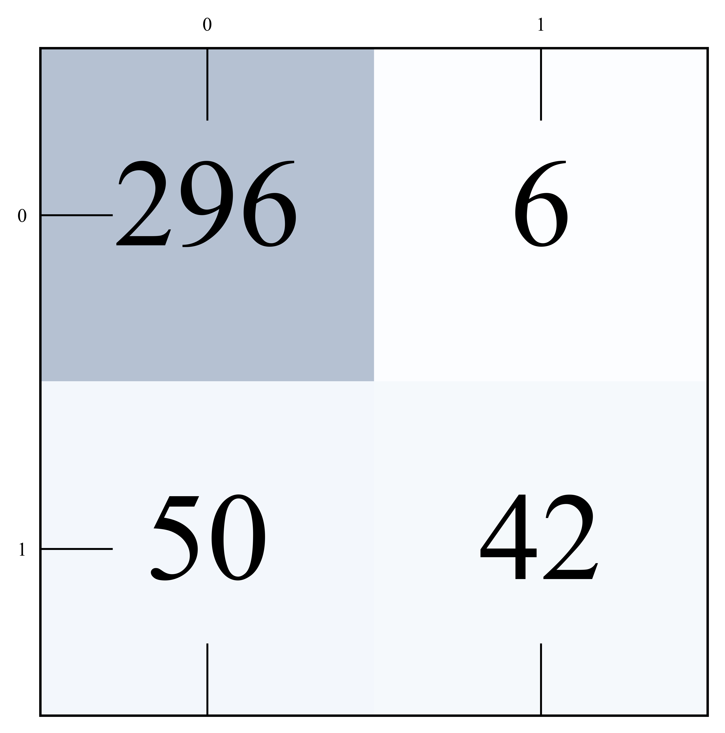
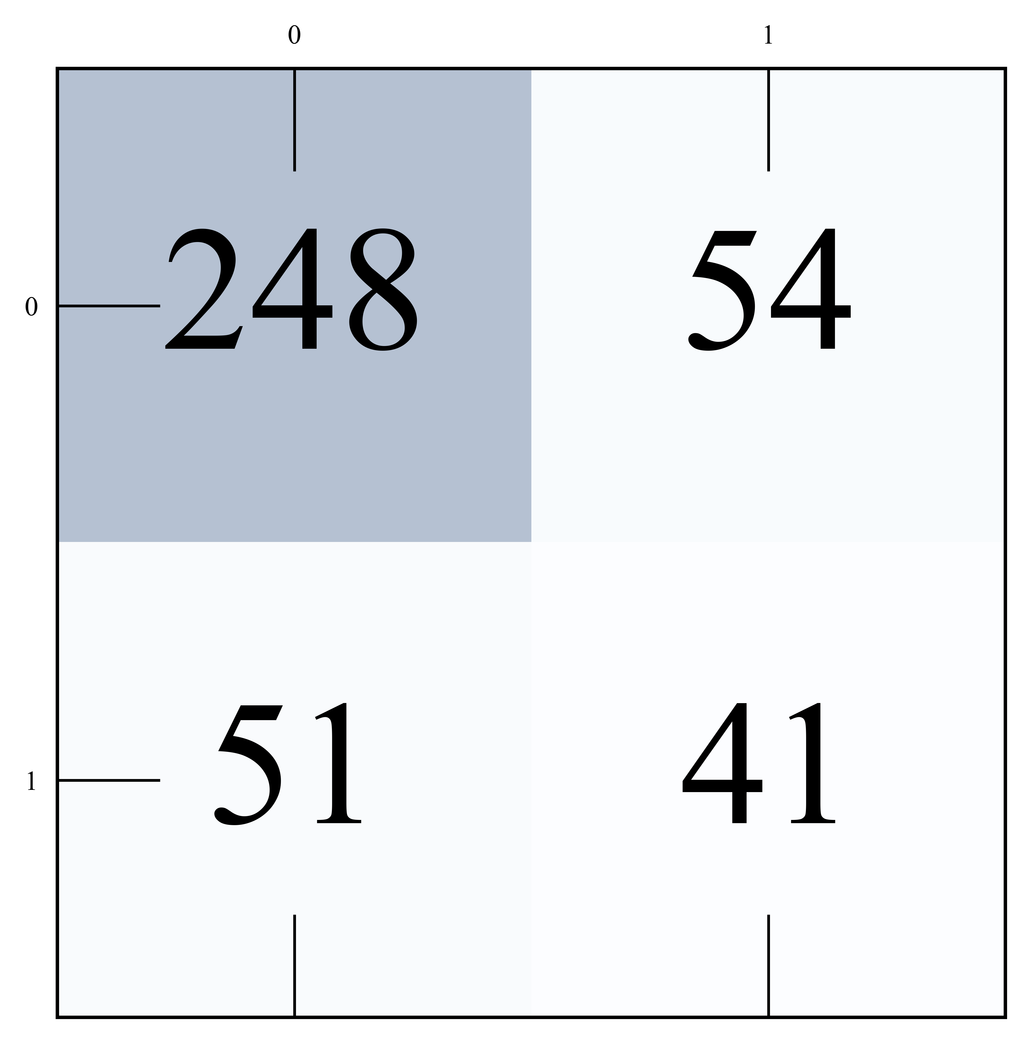
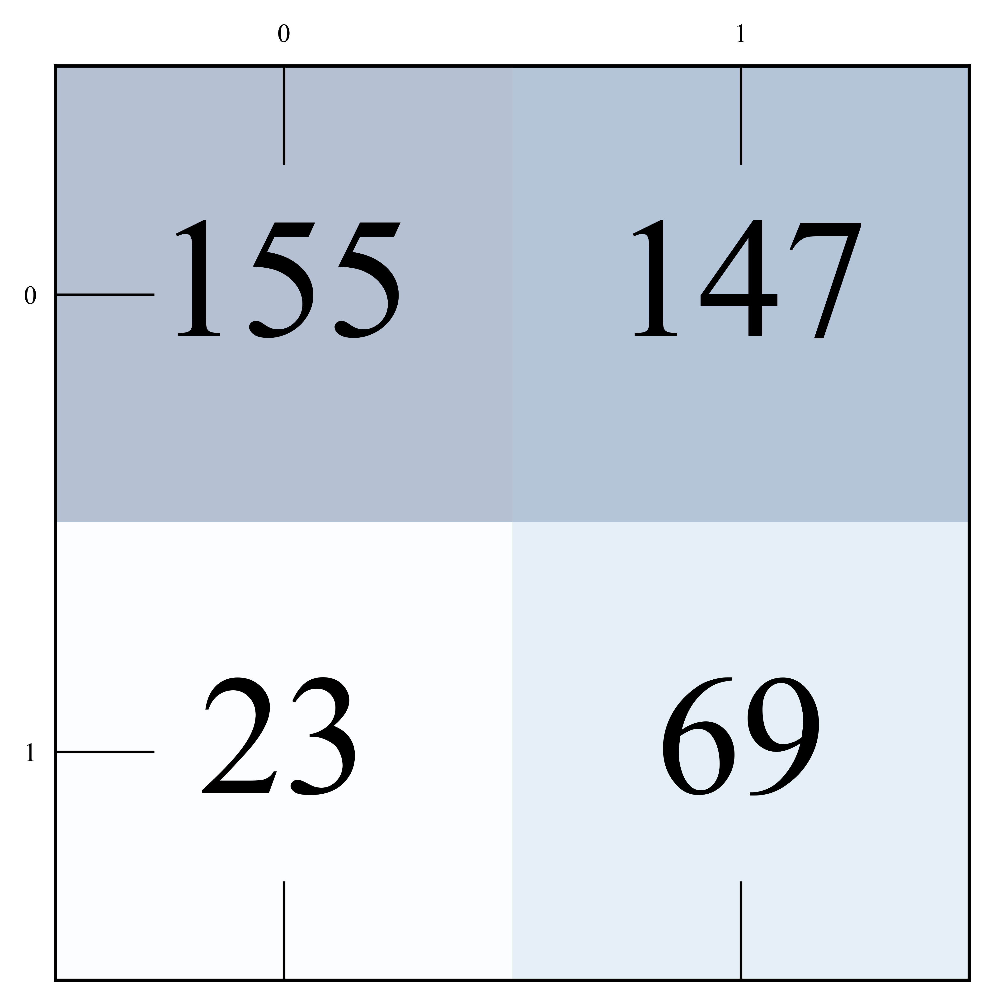
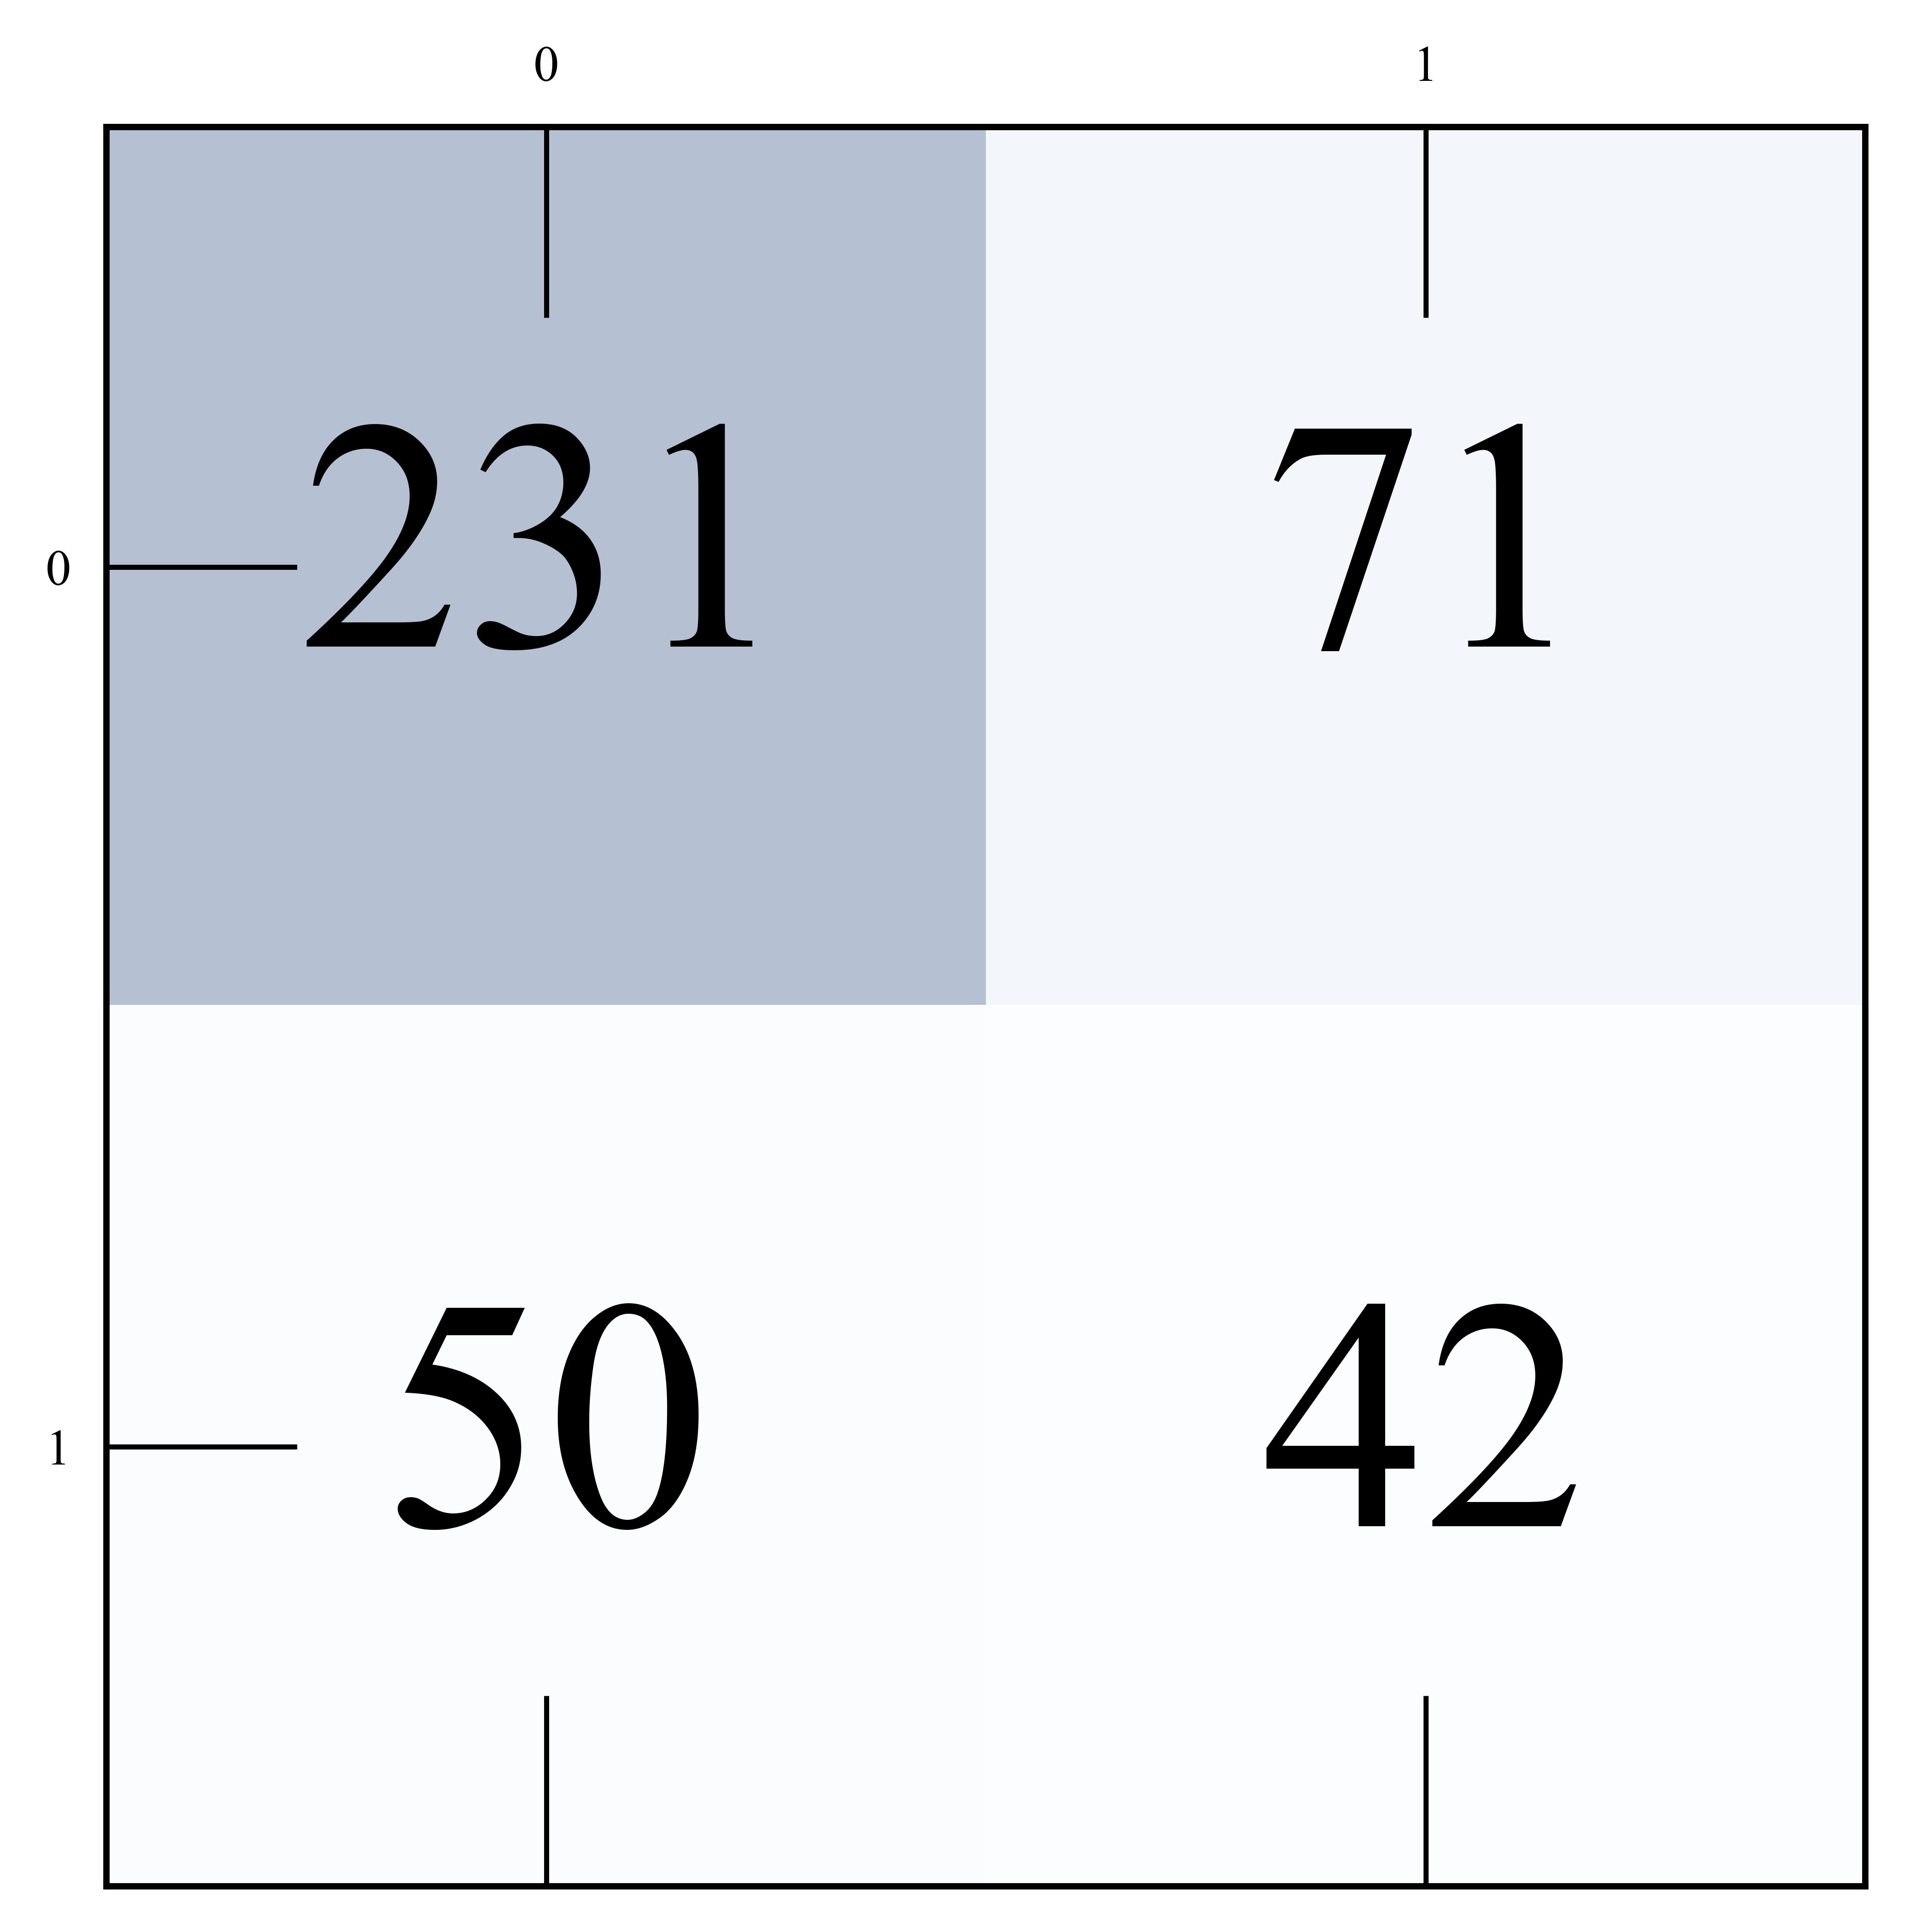
Actual Class
Actual Class
Predicted Class
Model A
Predicted Class
Model B
Actual Class
Actual Class
Predicted Class
Model C
Predicted Class
Model D

Slide 9
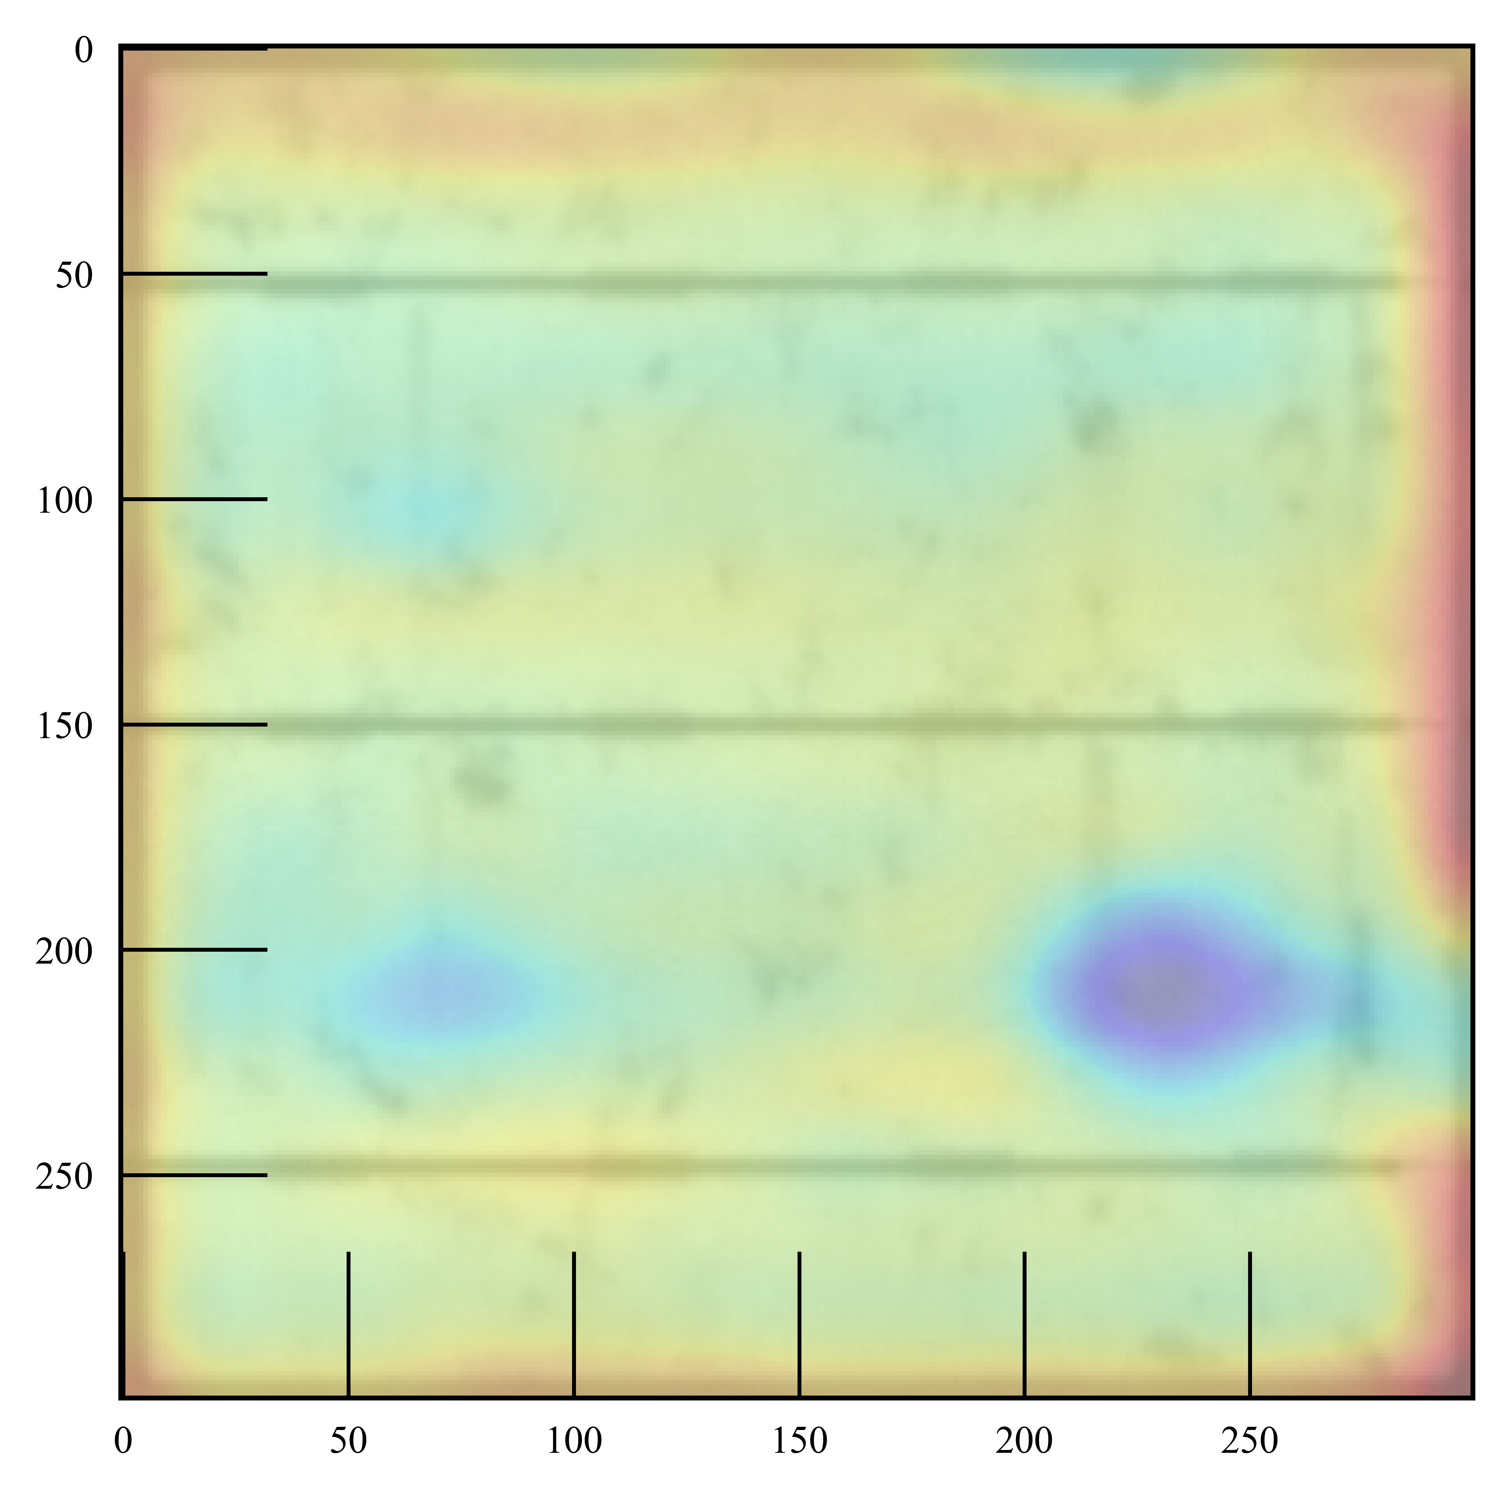
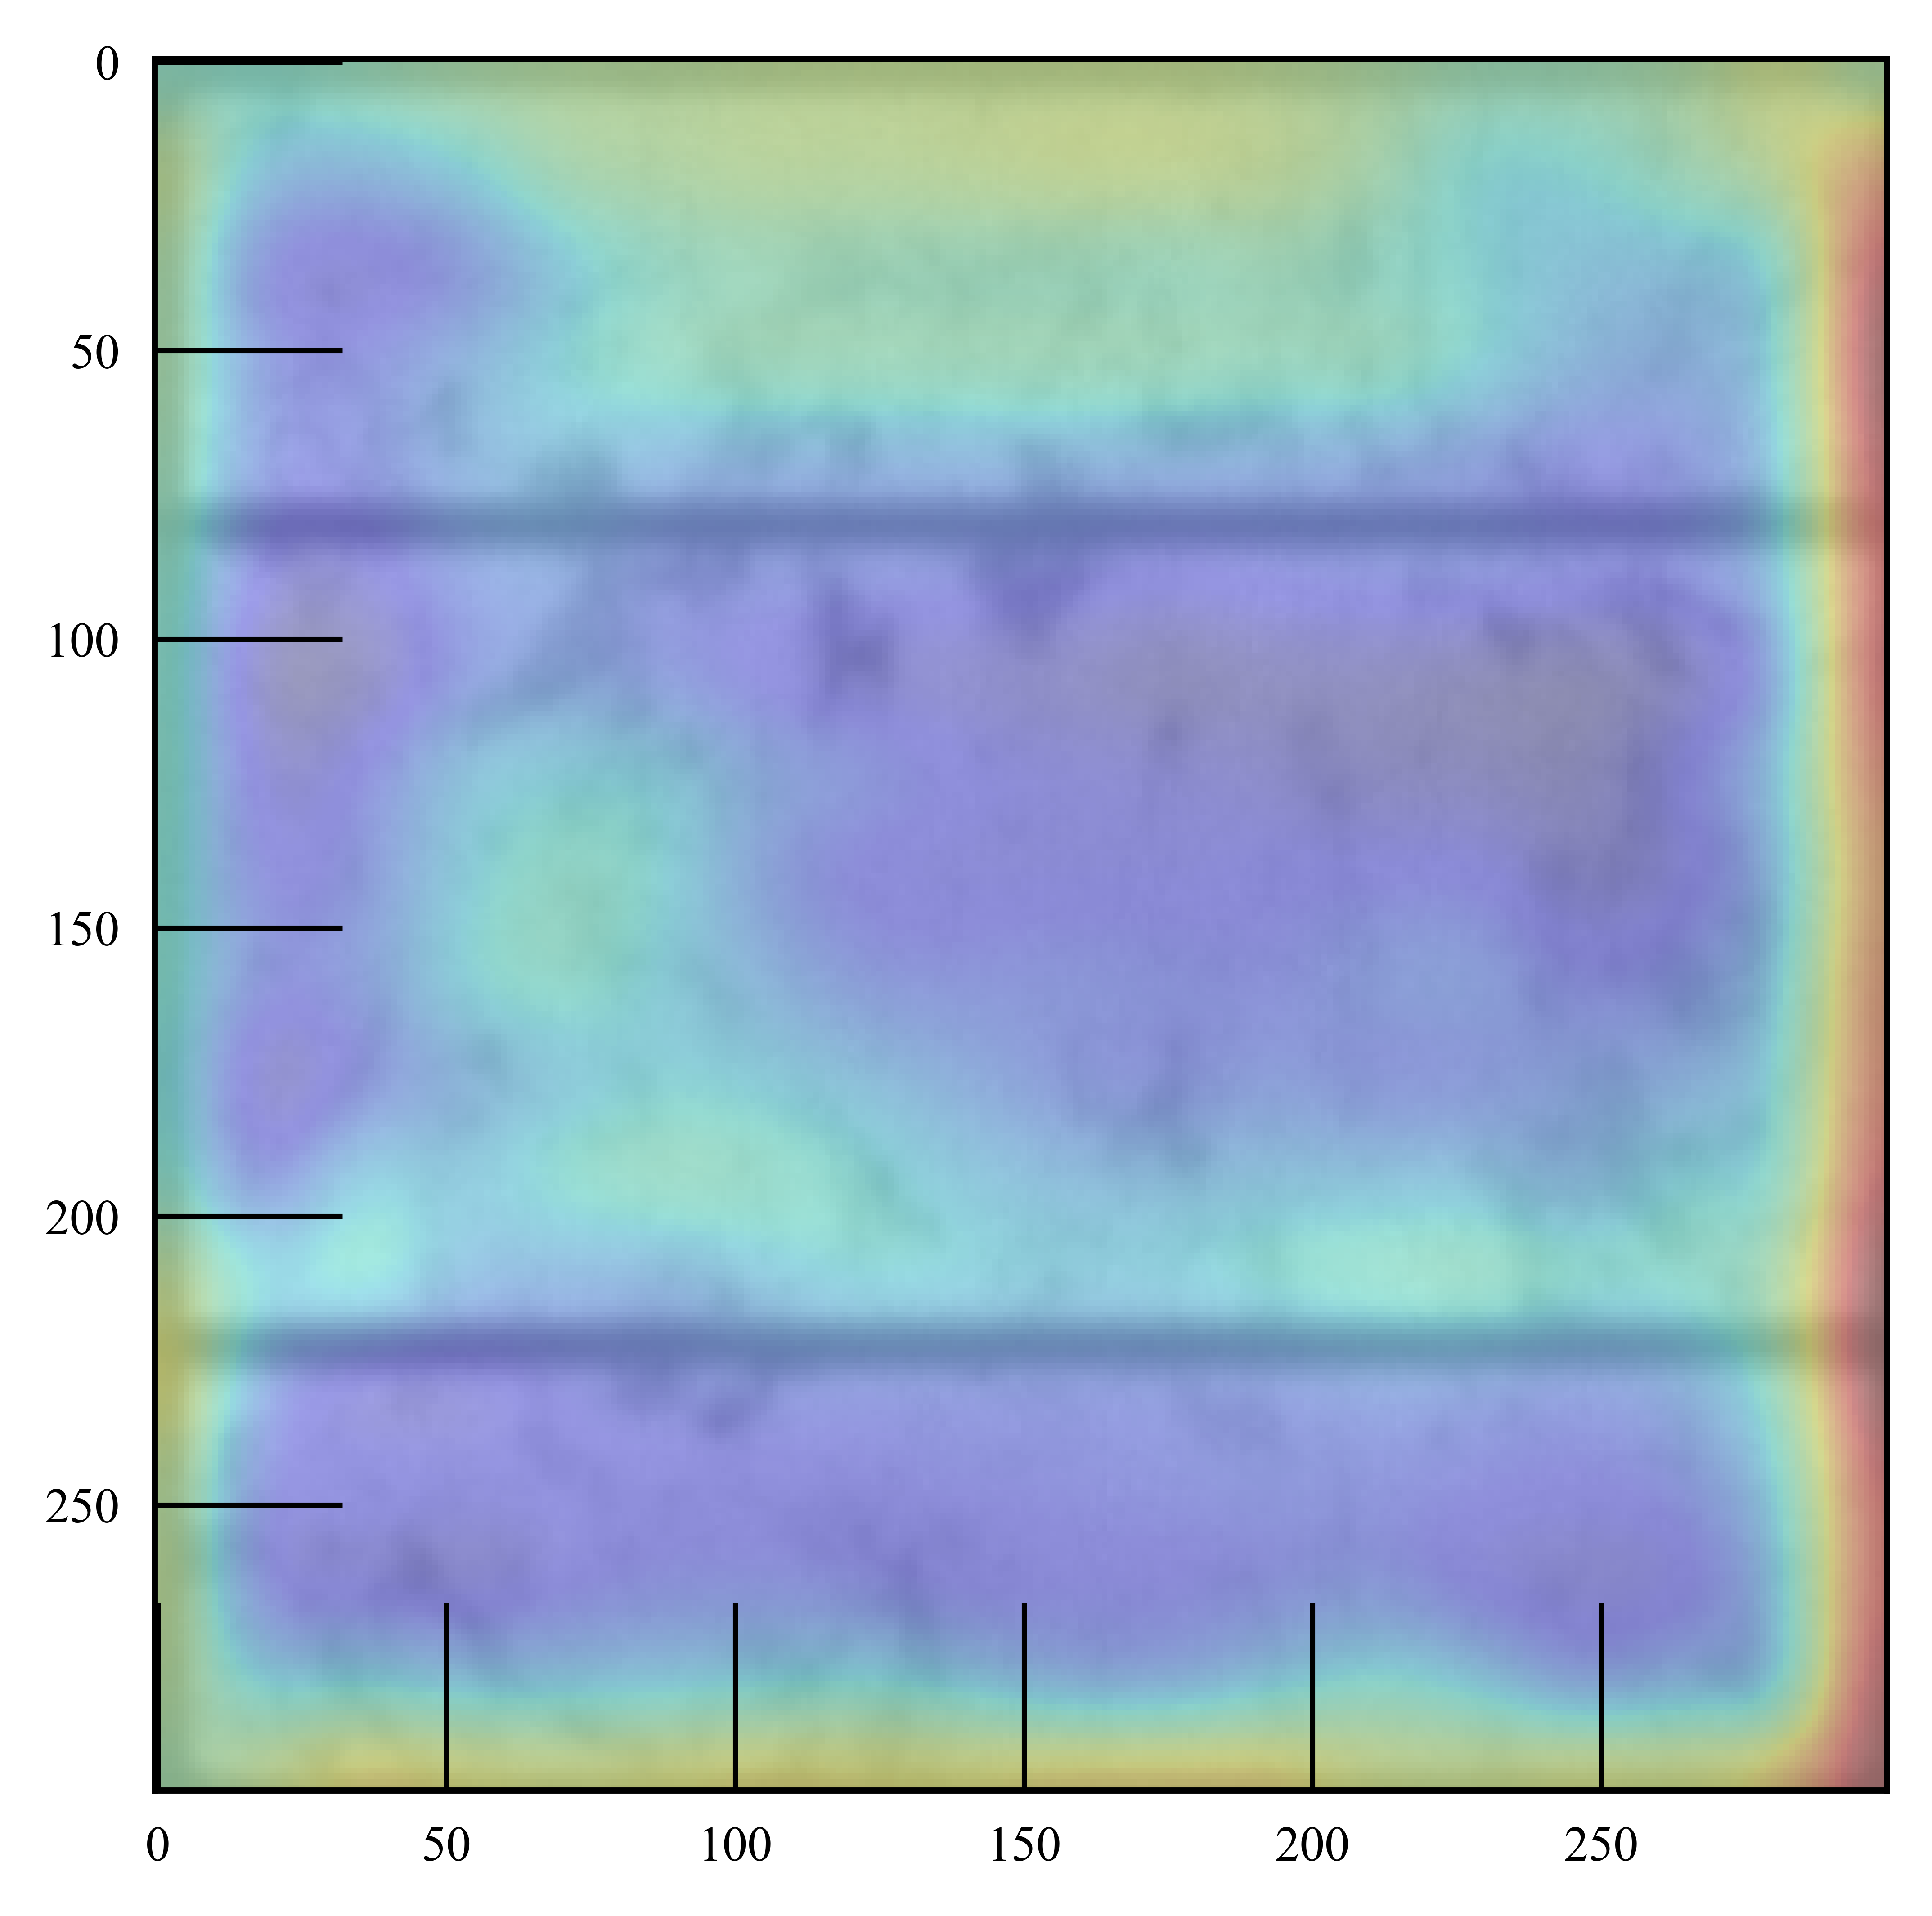
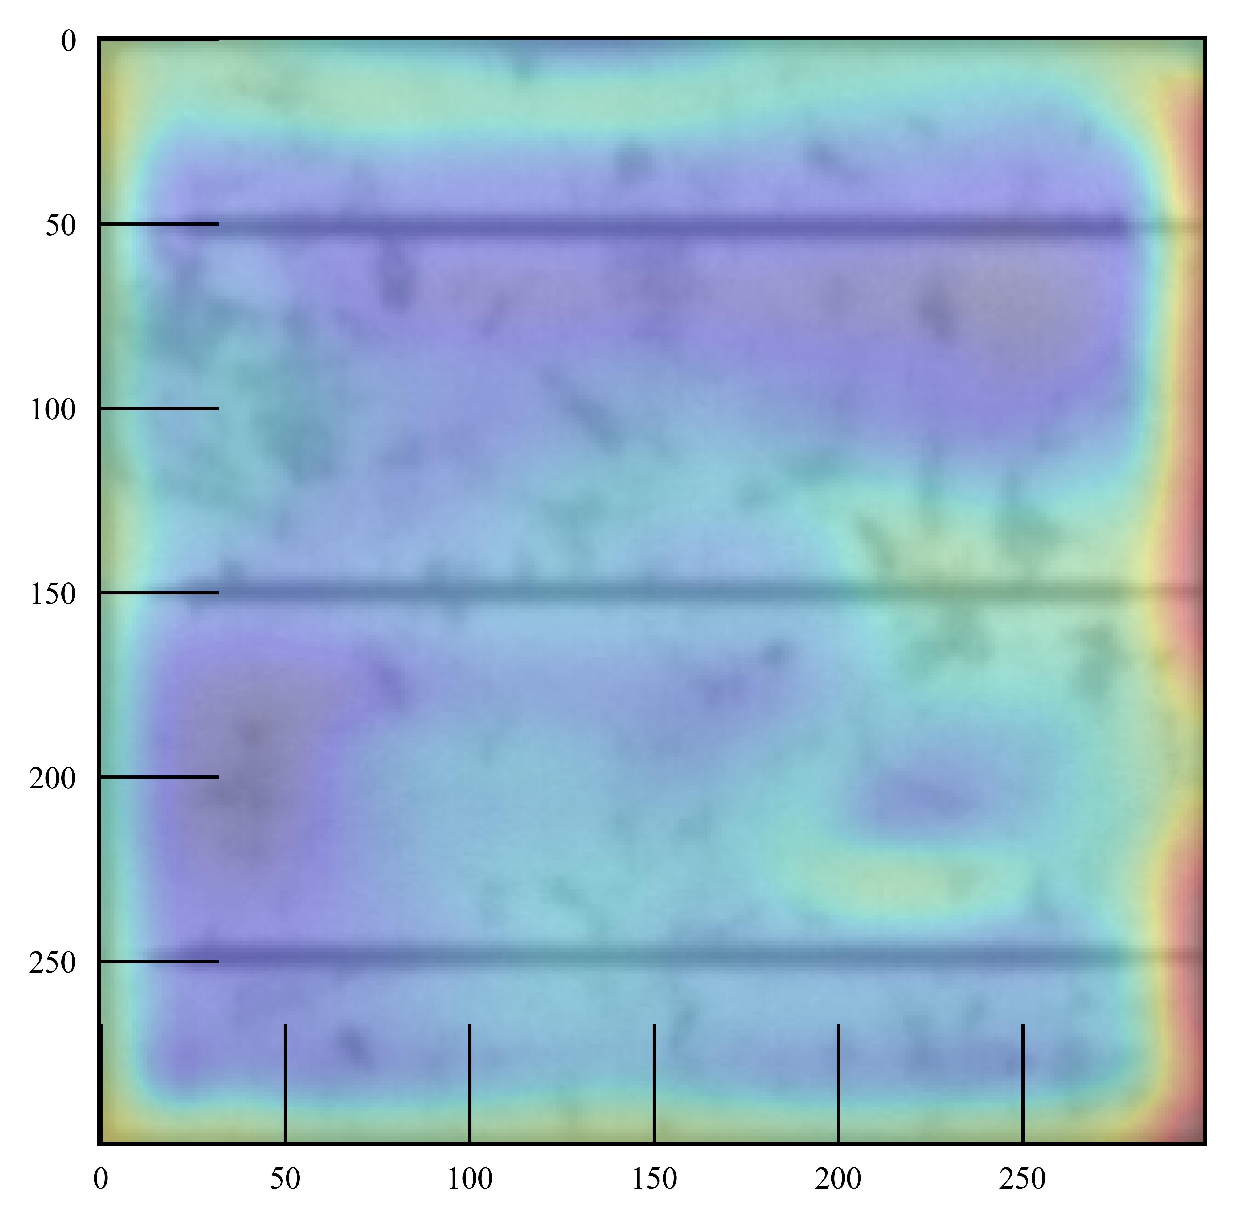
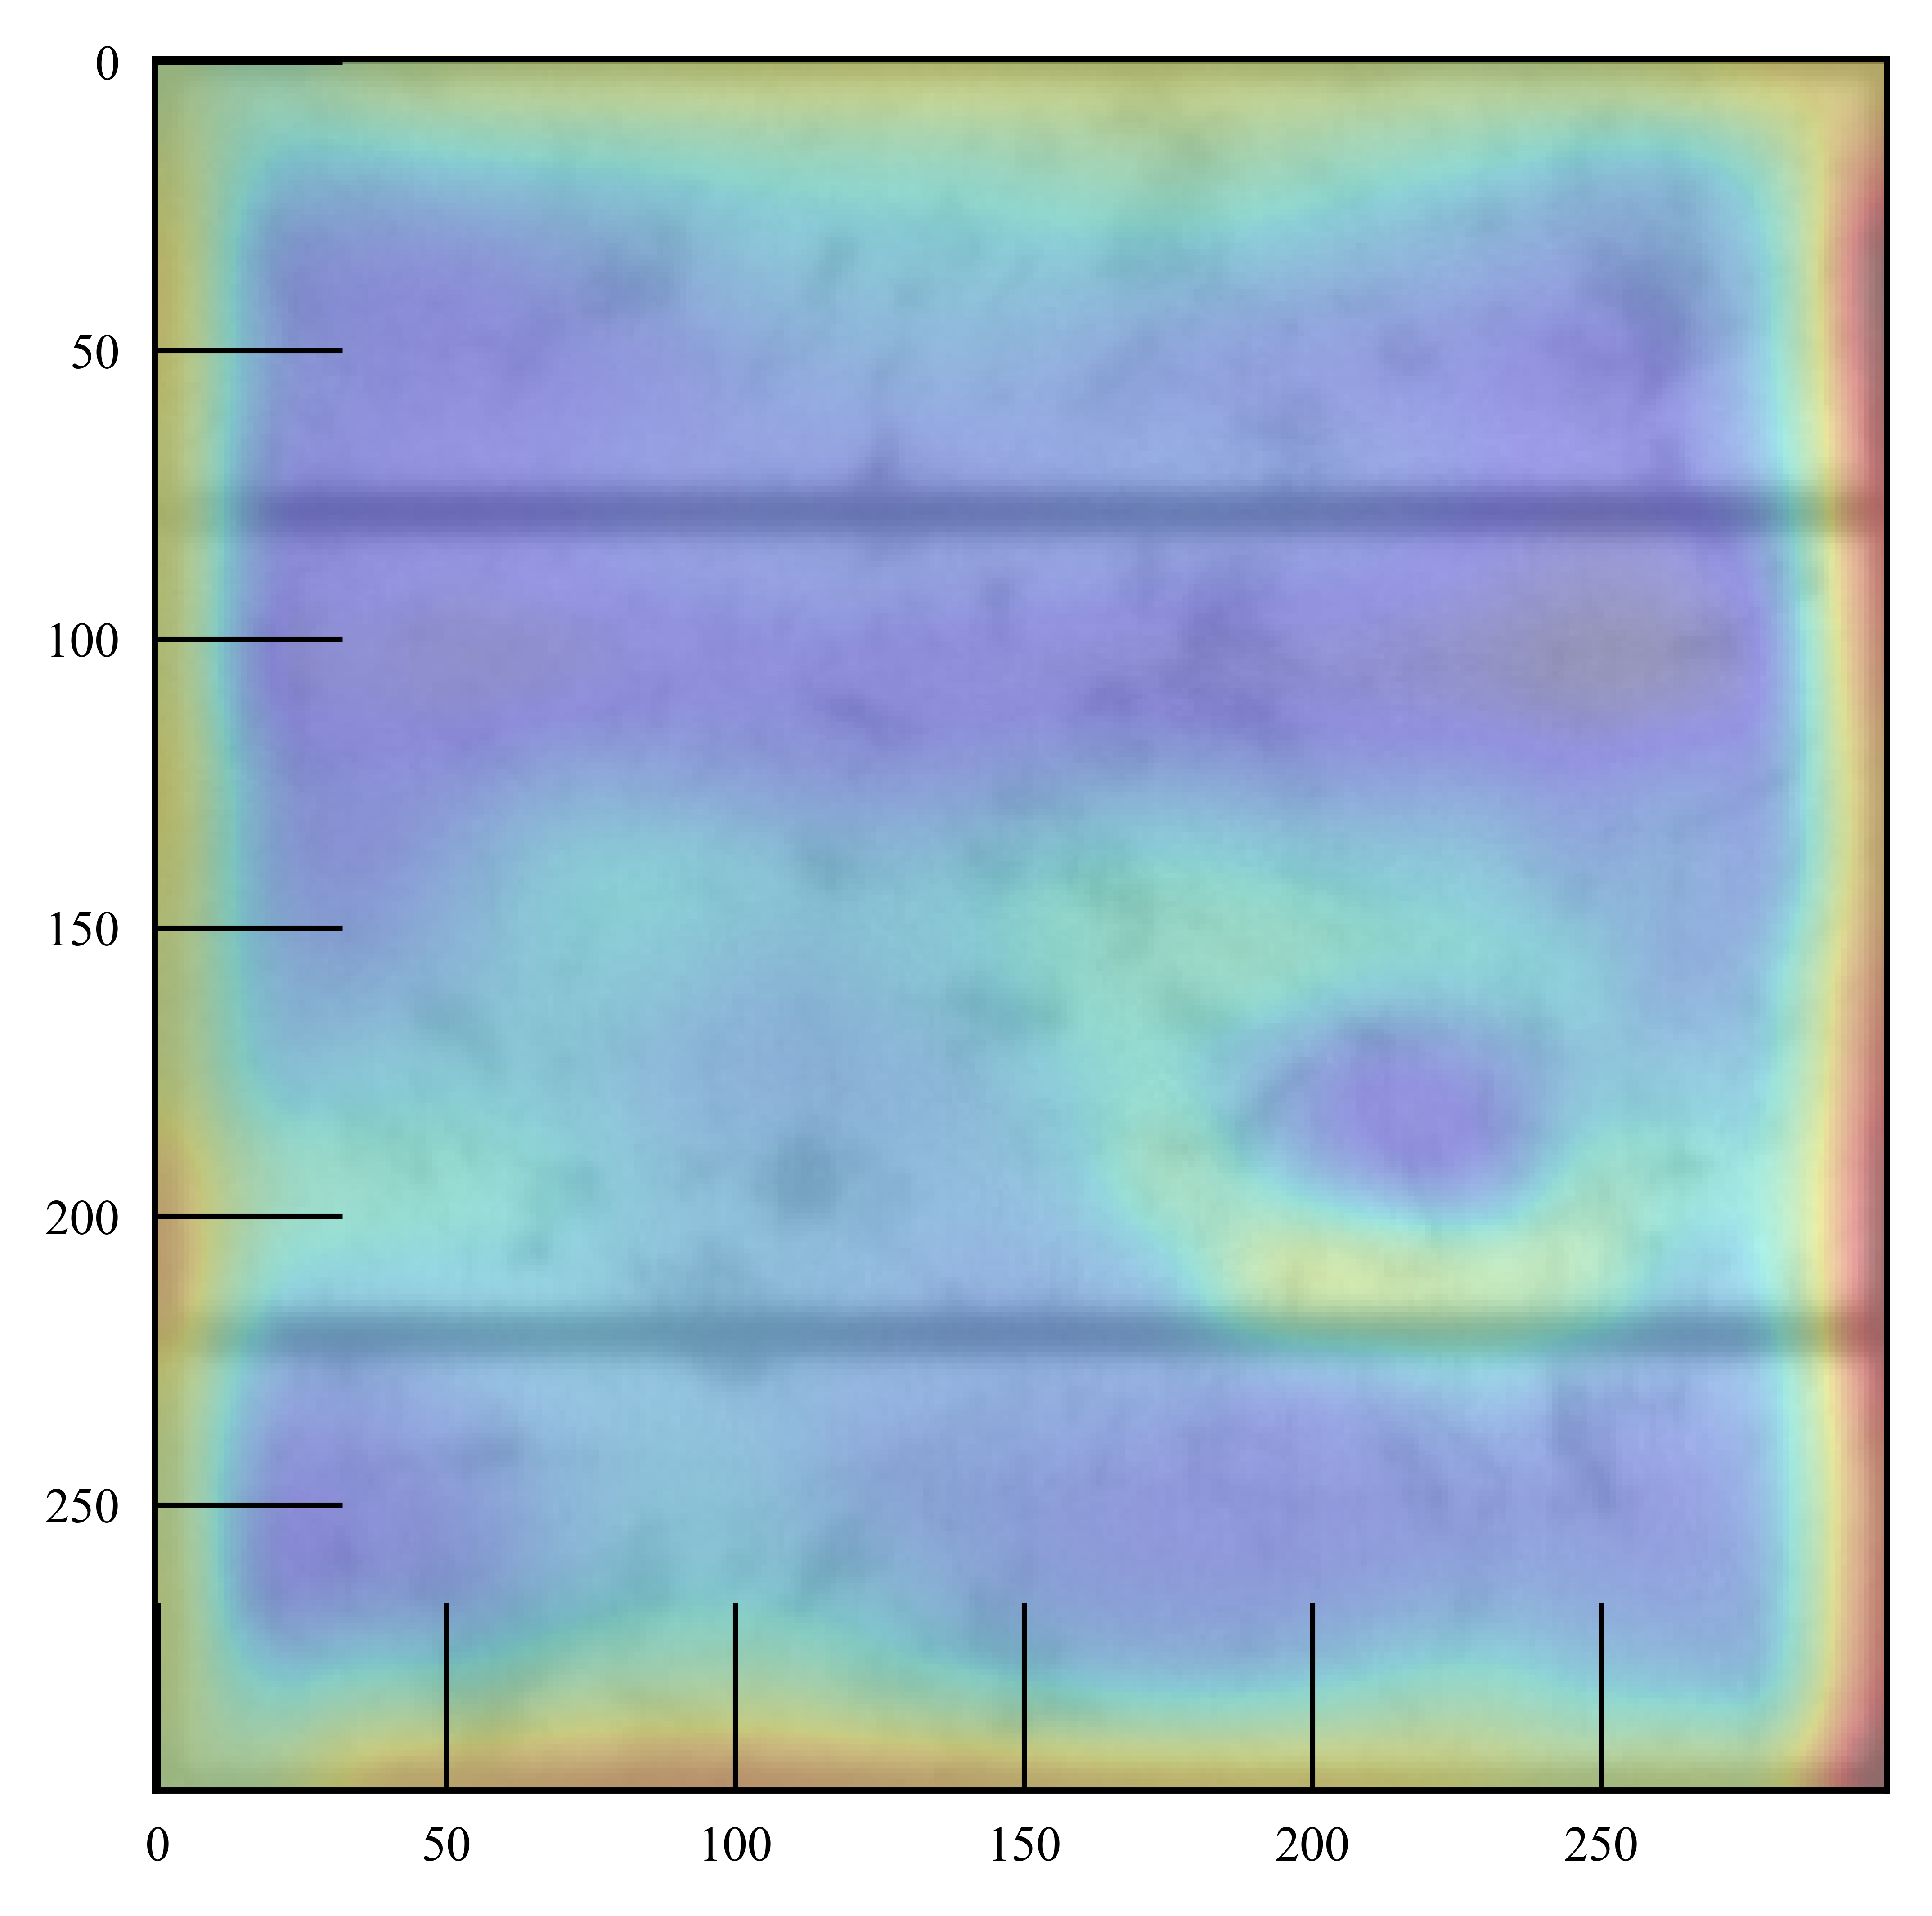
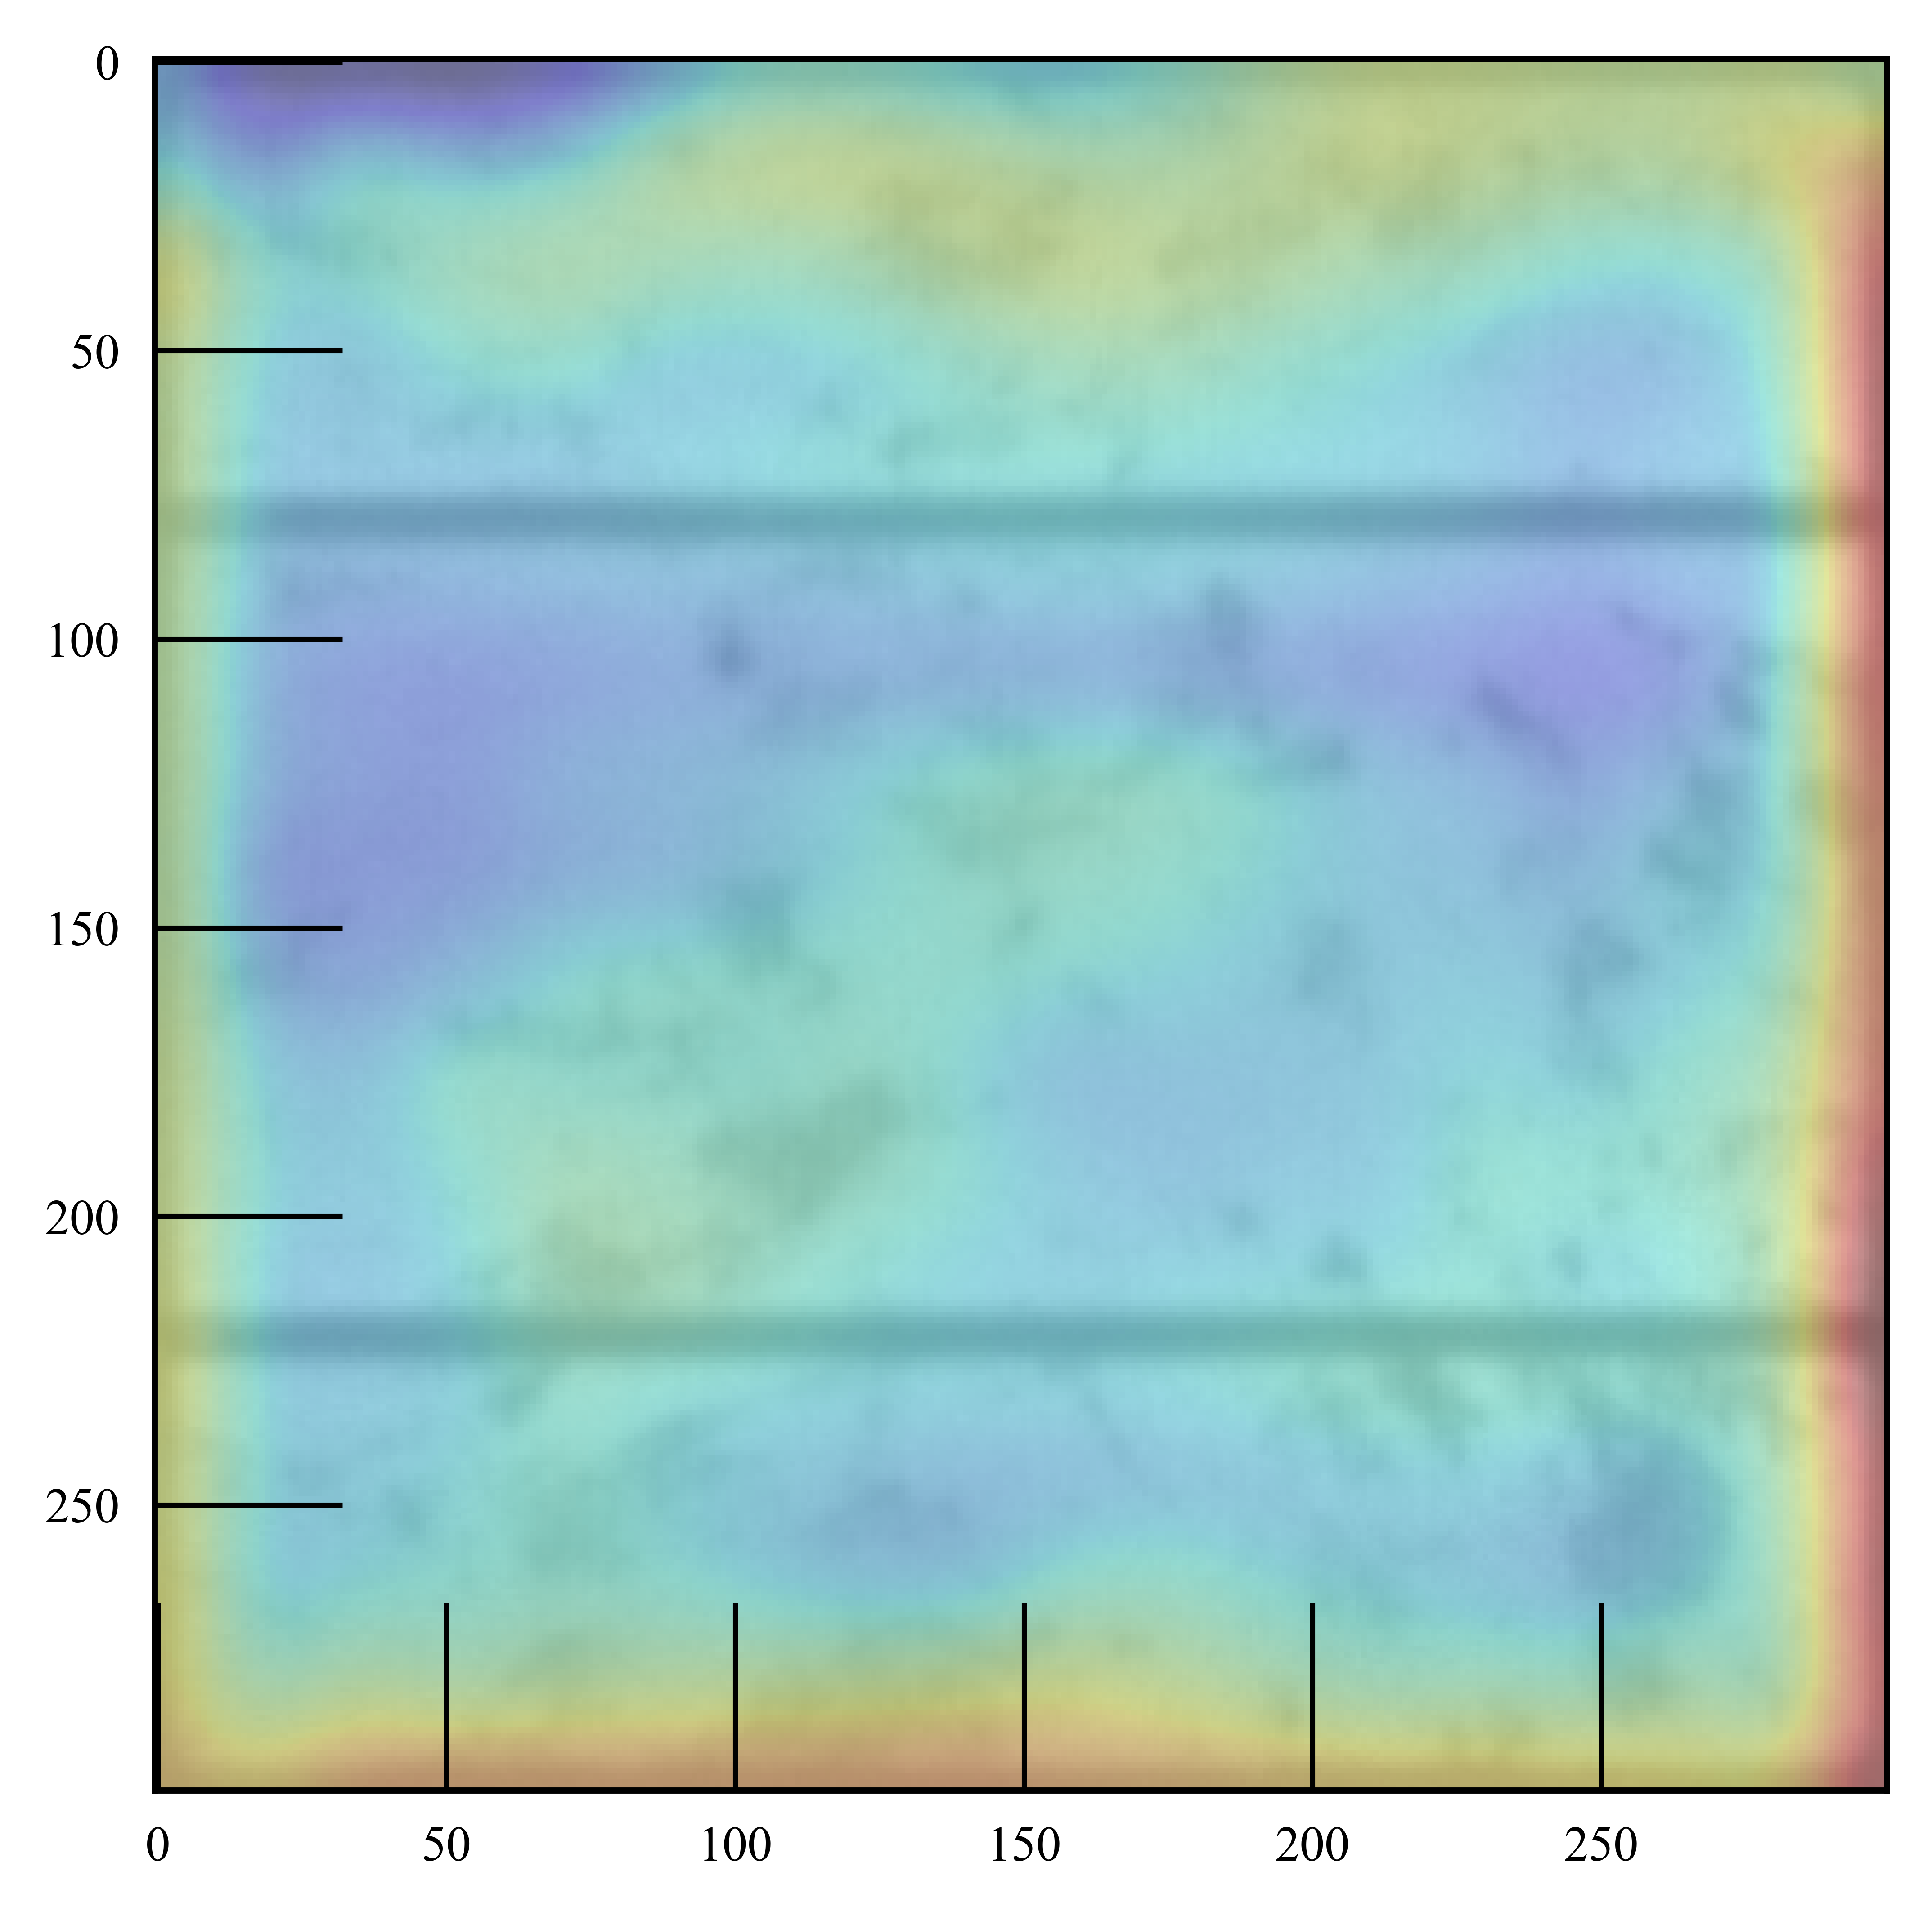
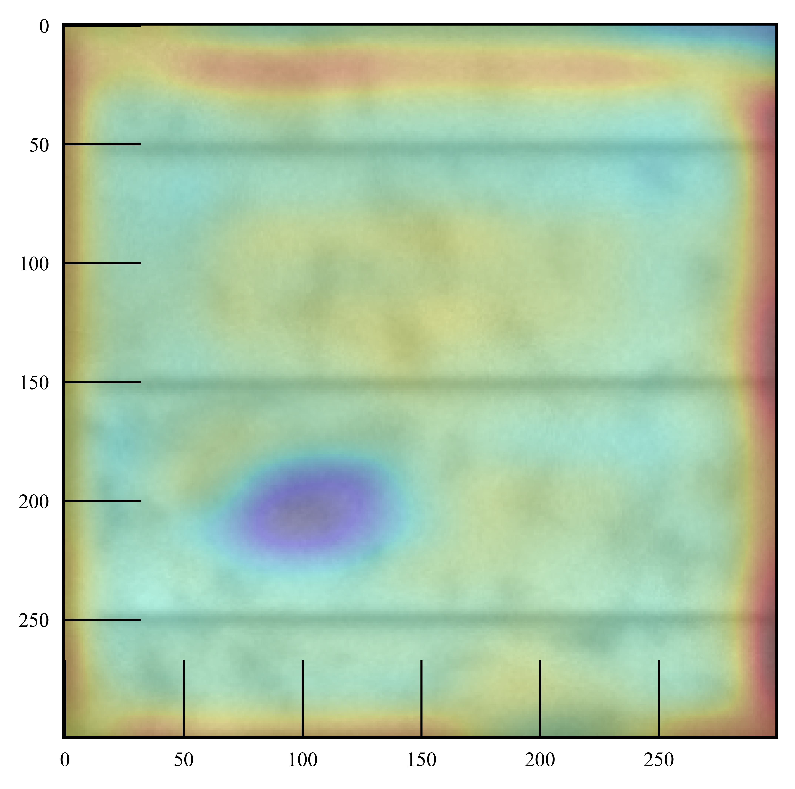
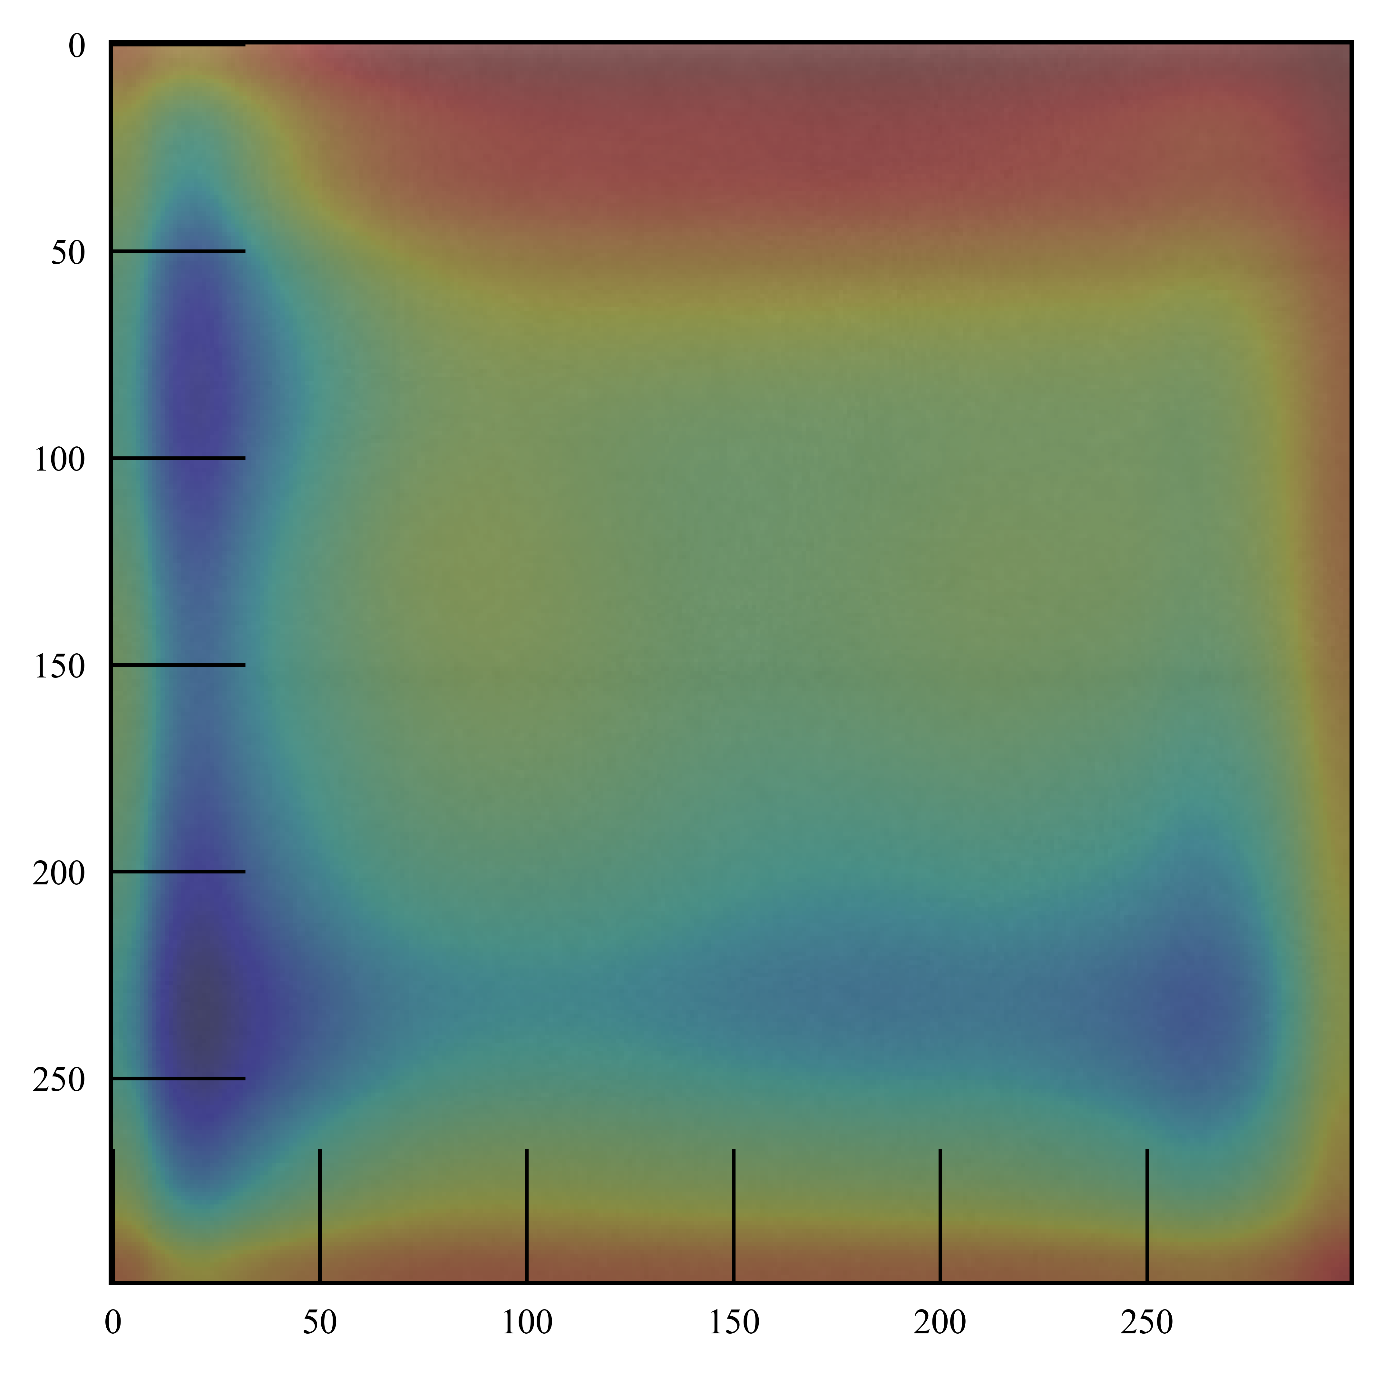
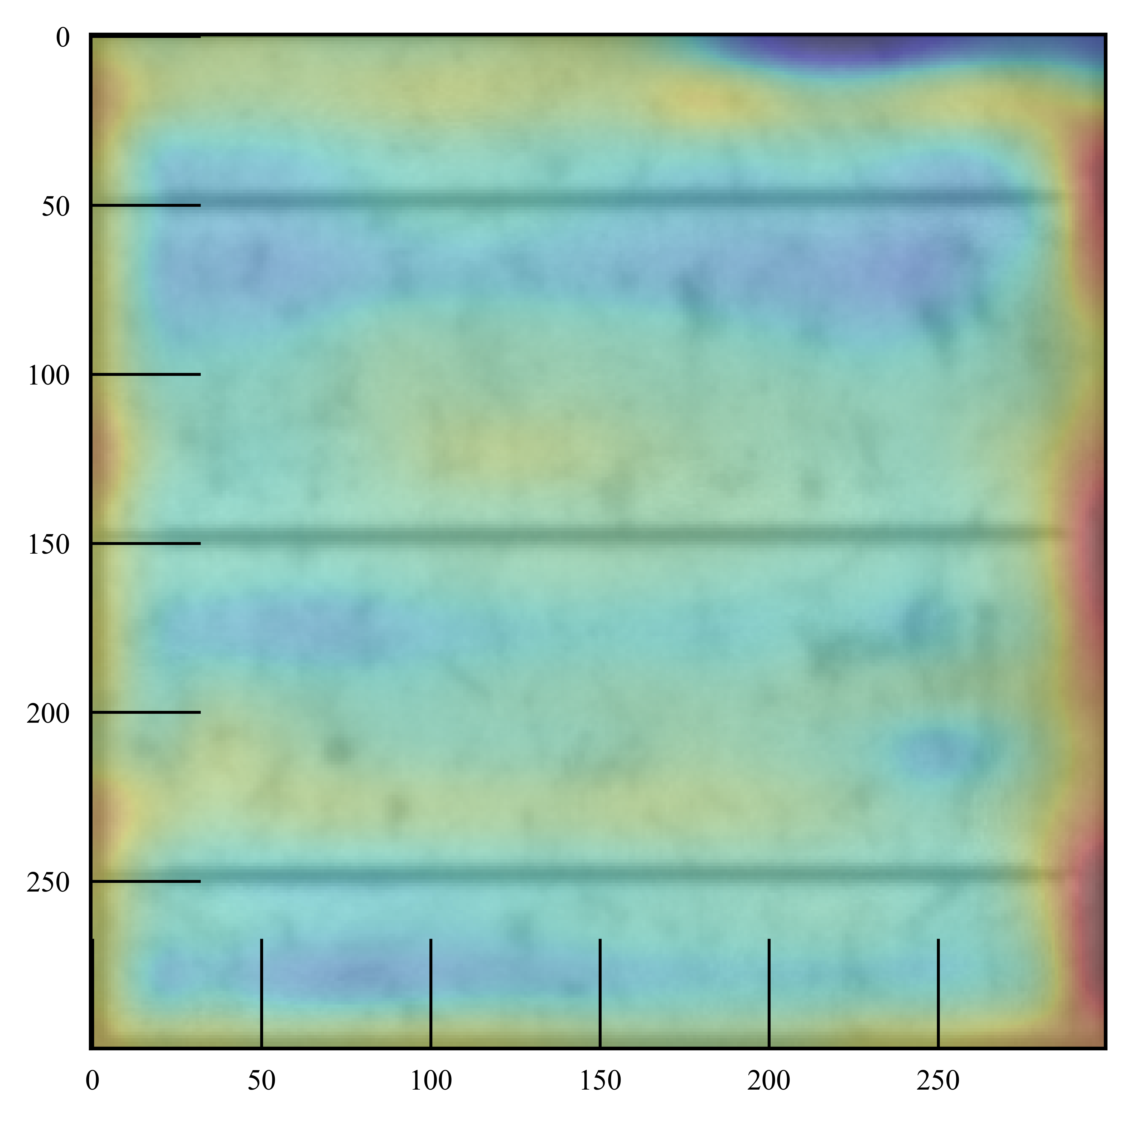
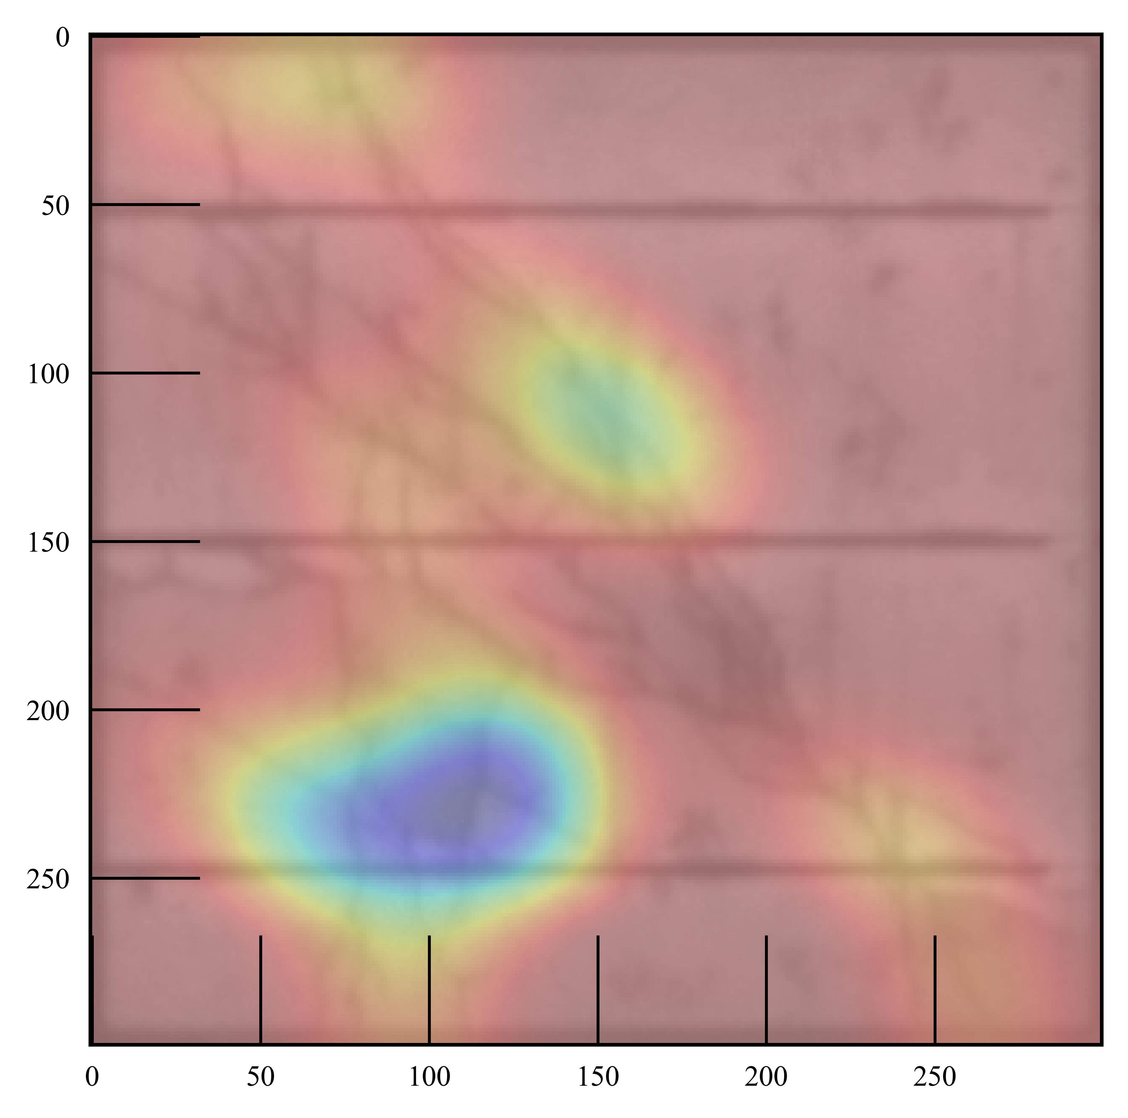
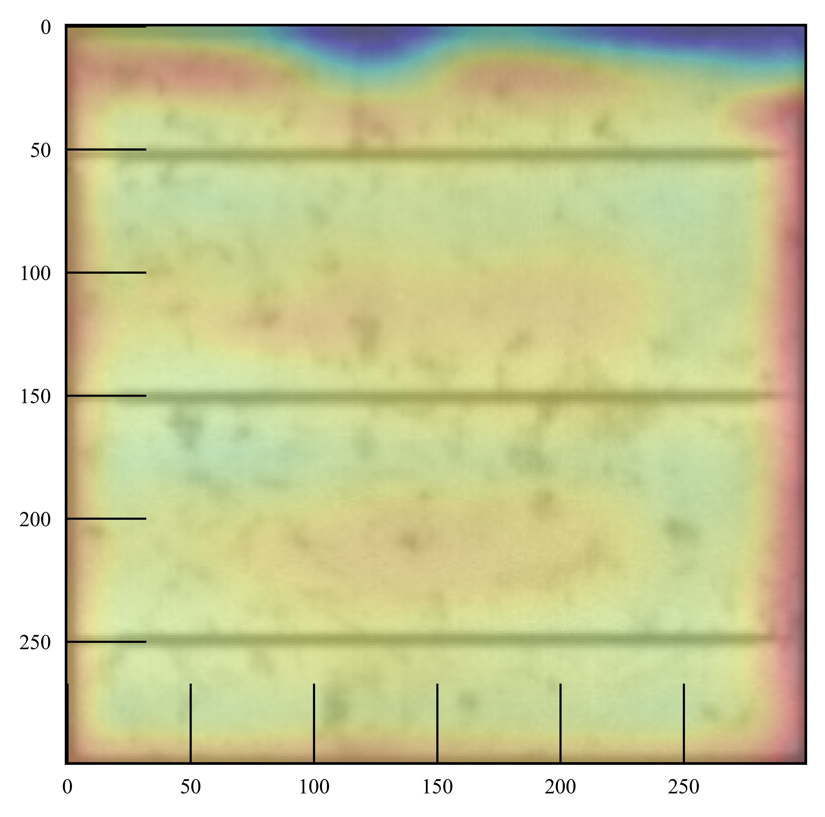
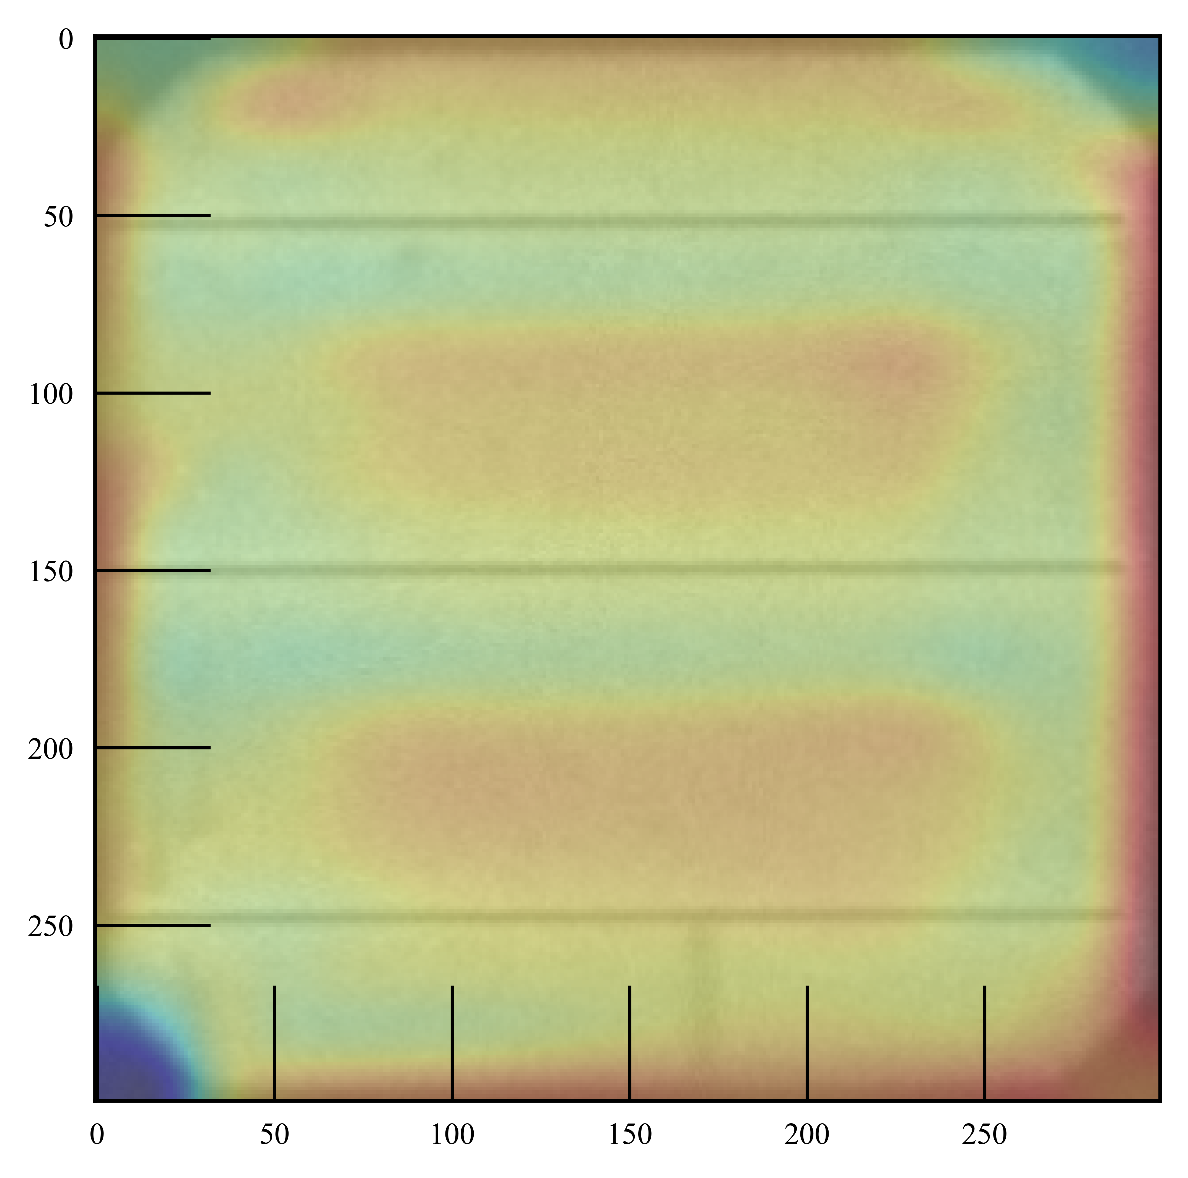
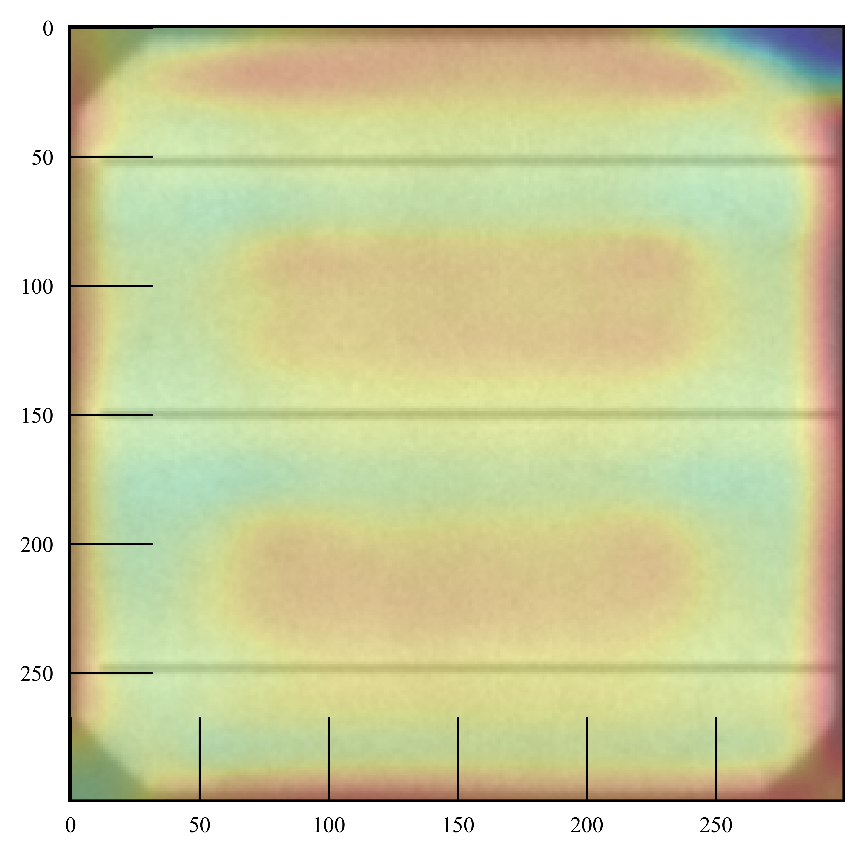
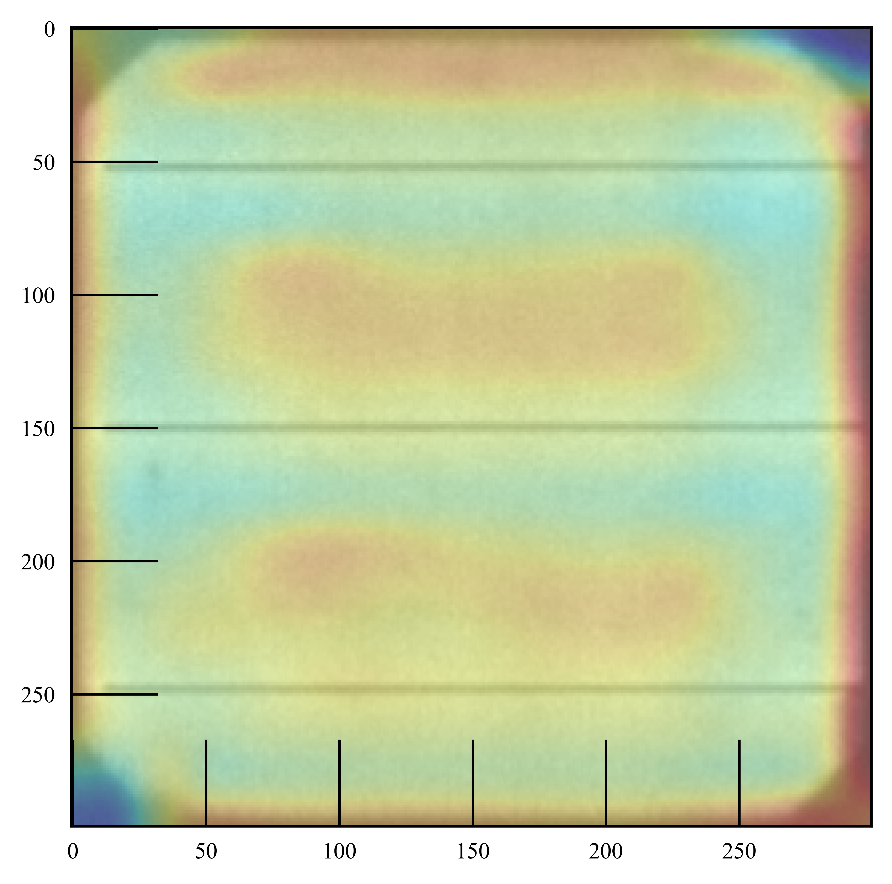
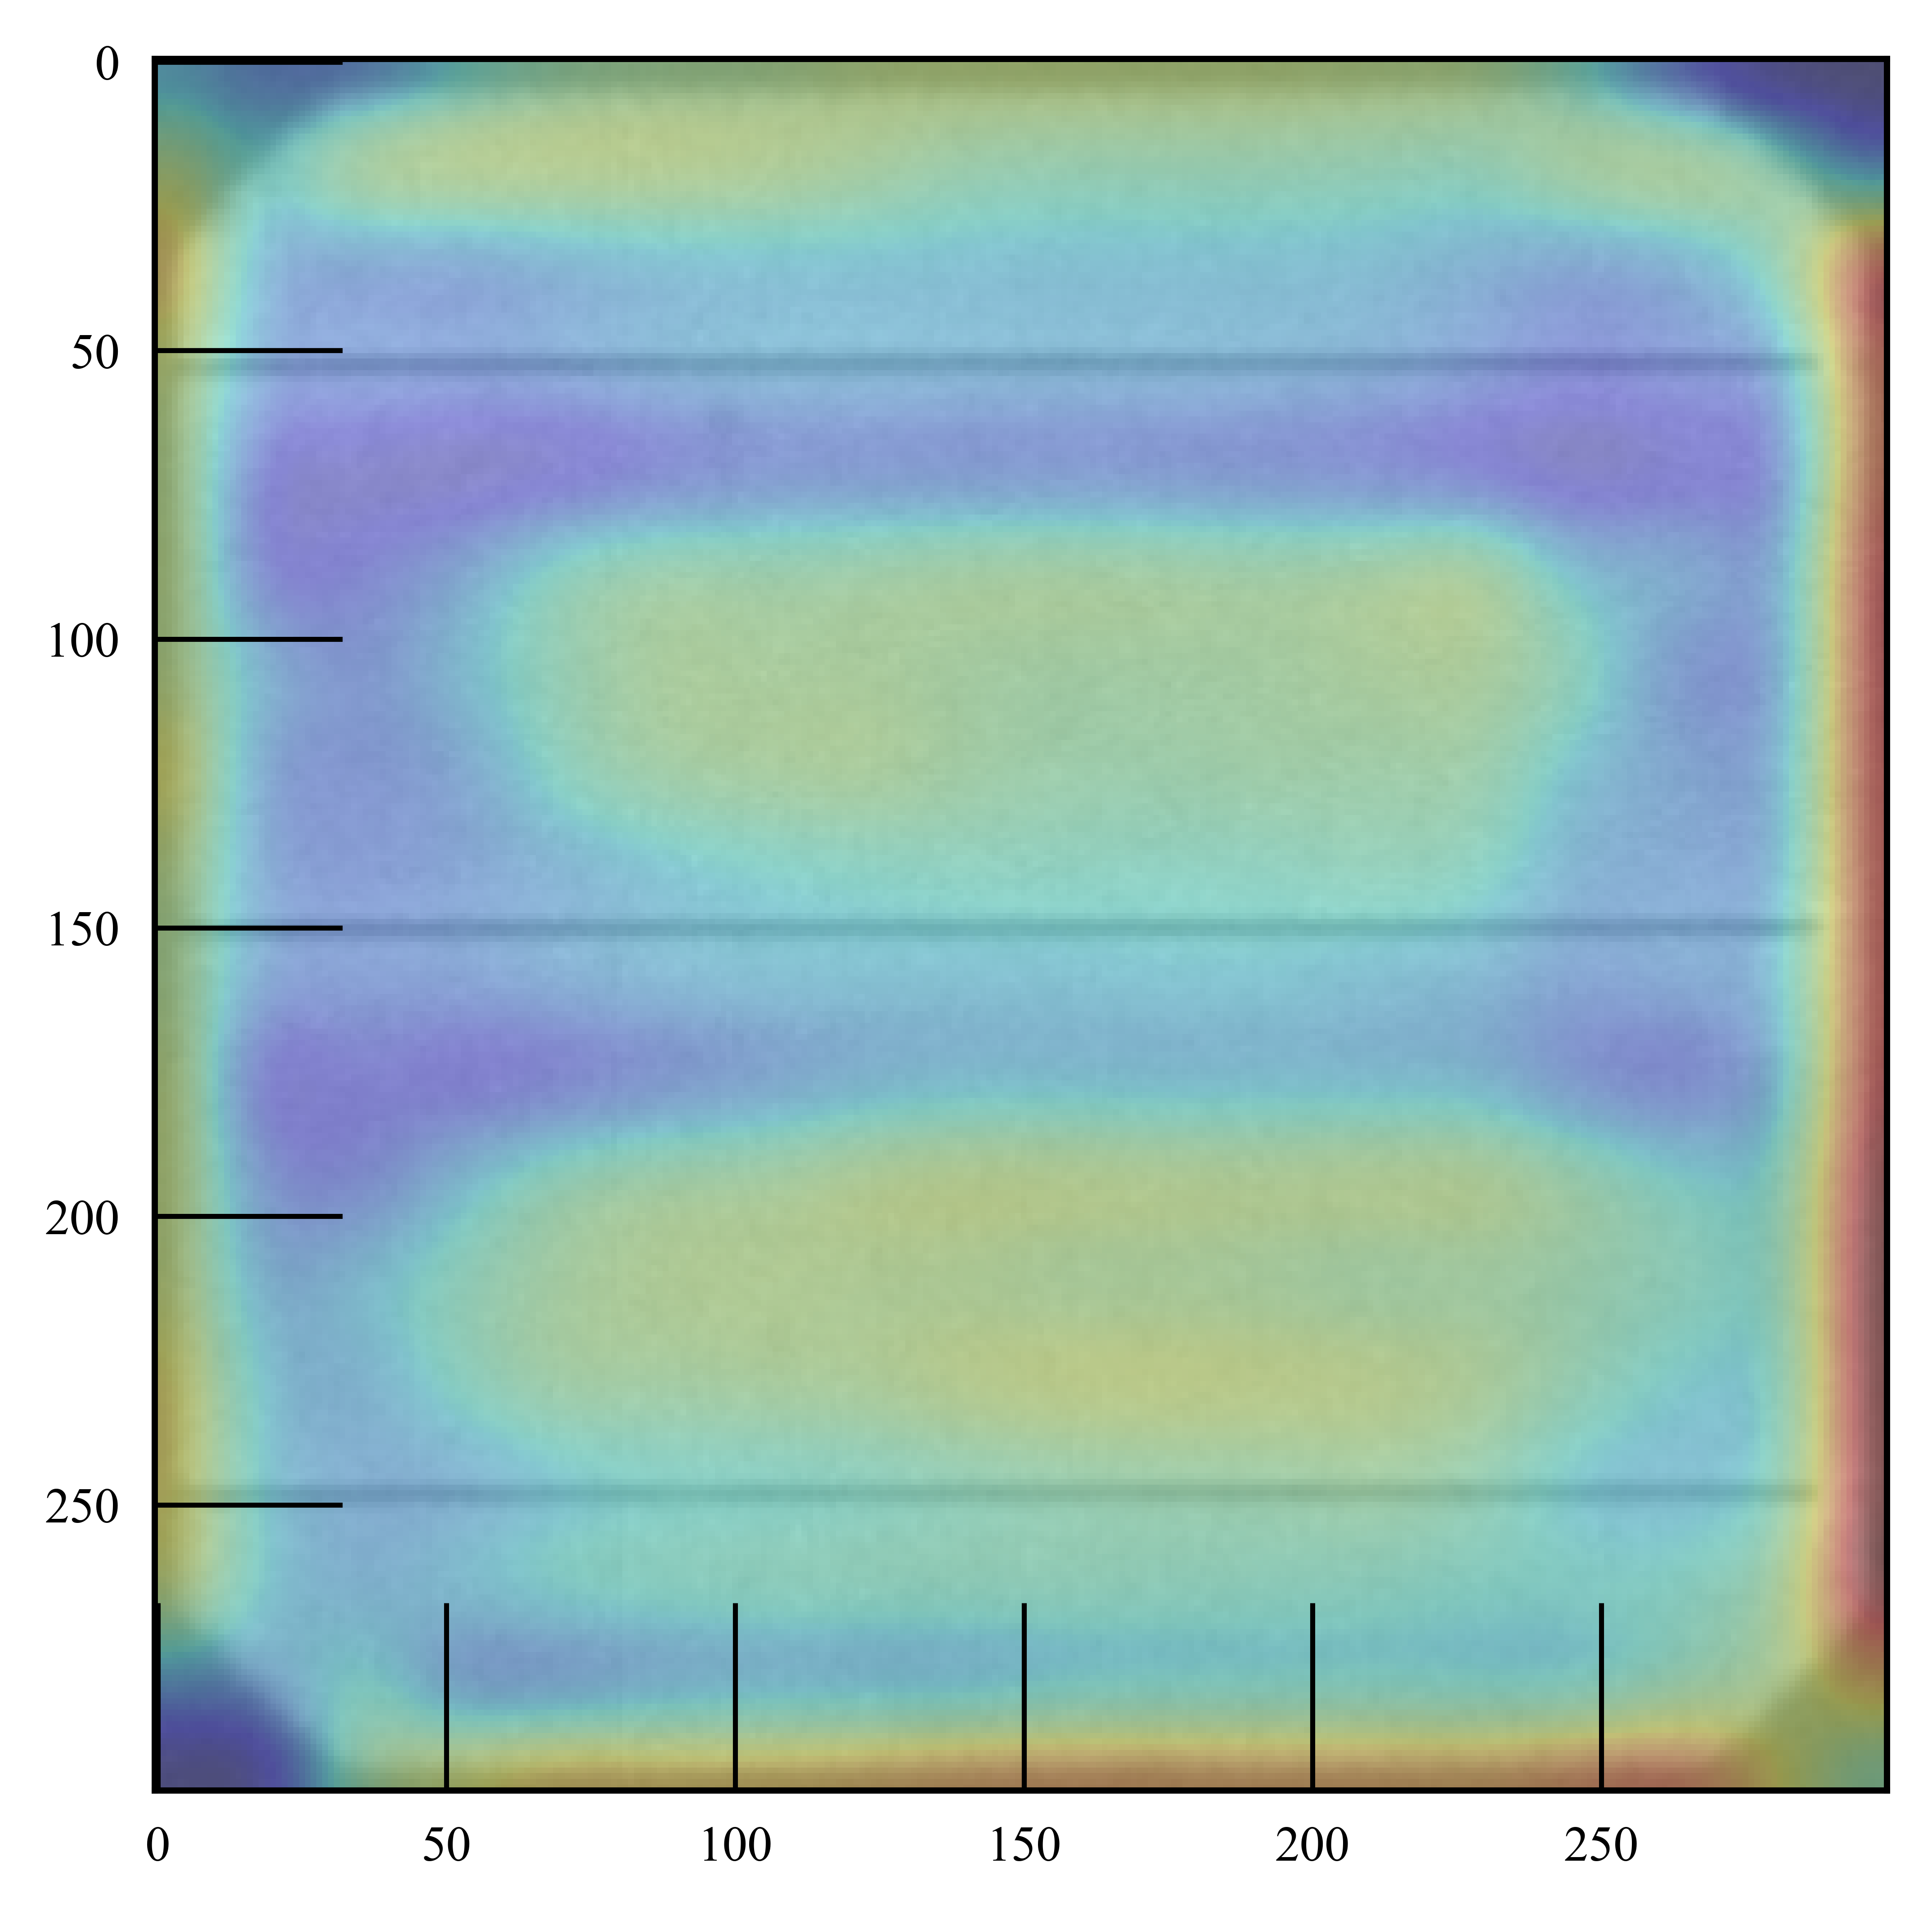
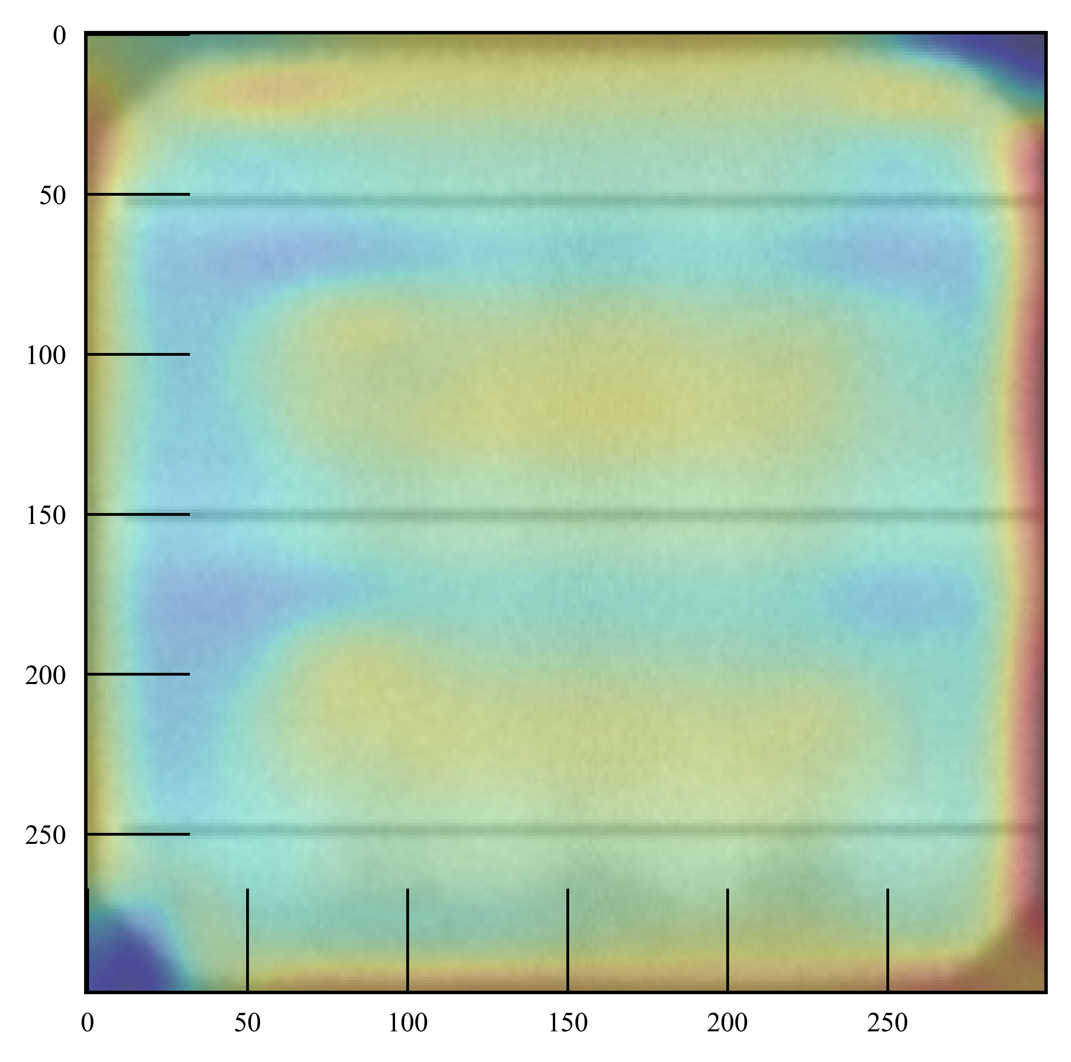
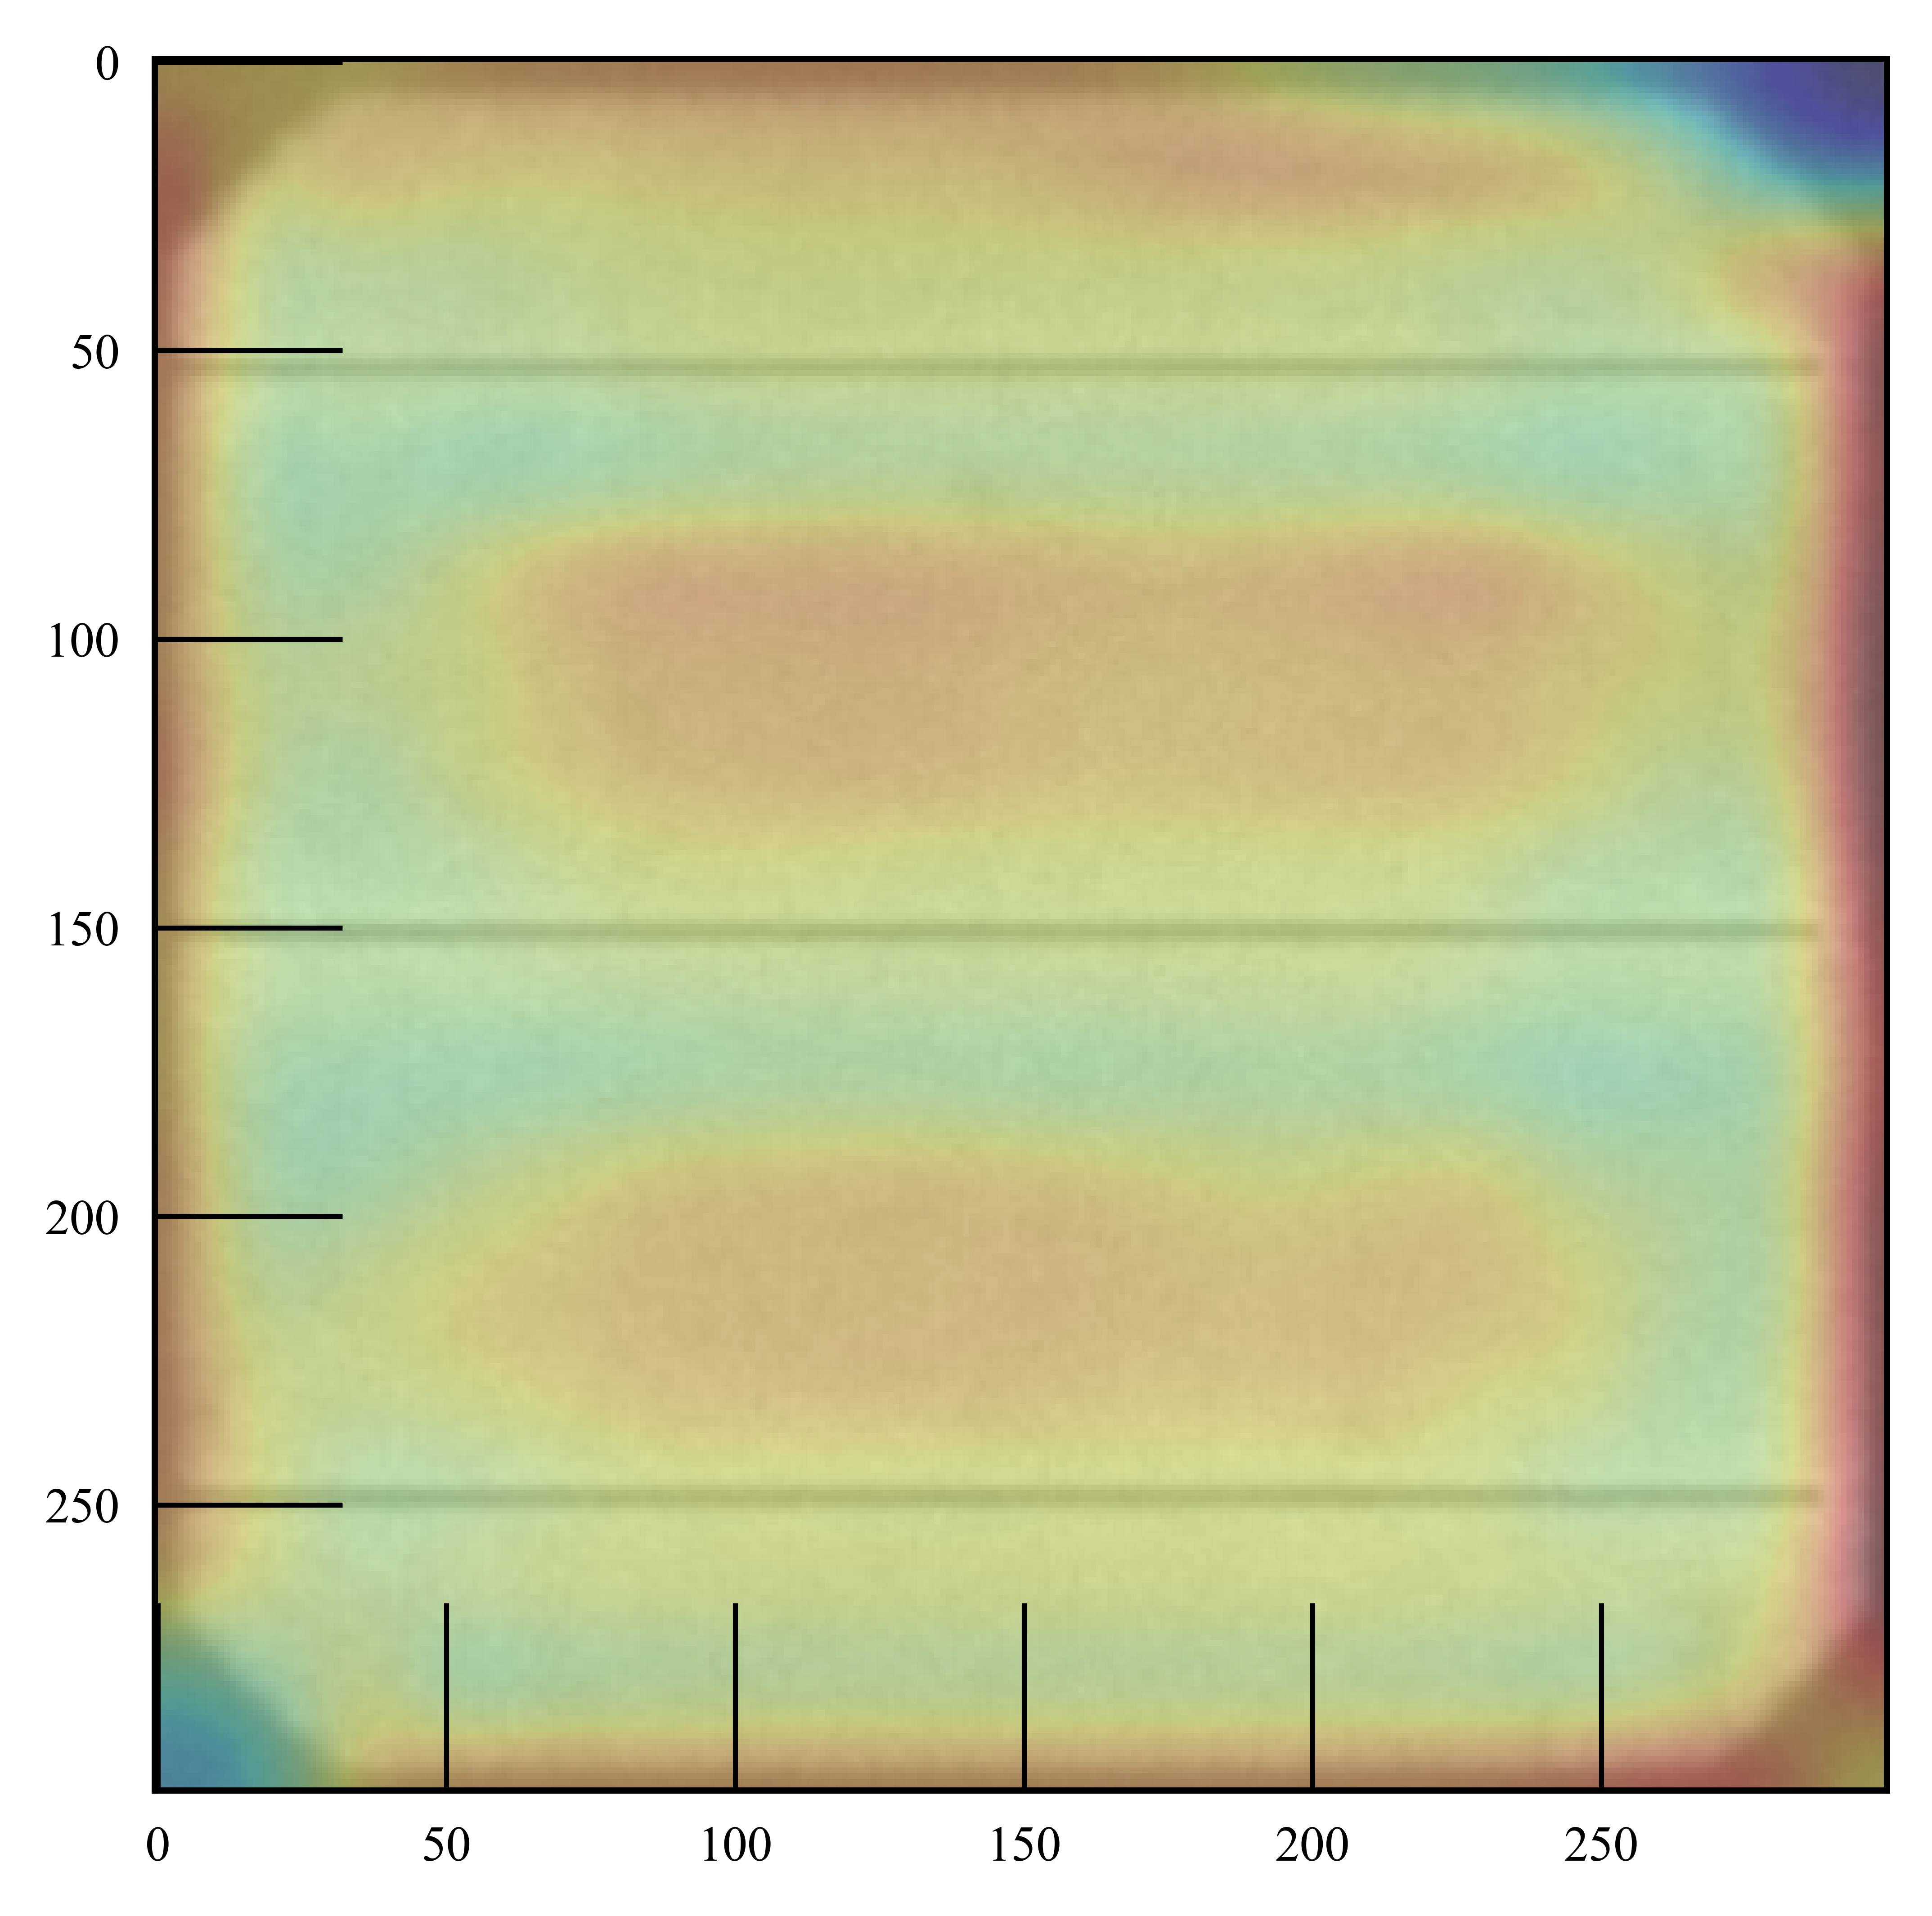
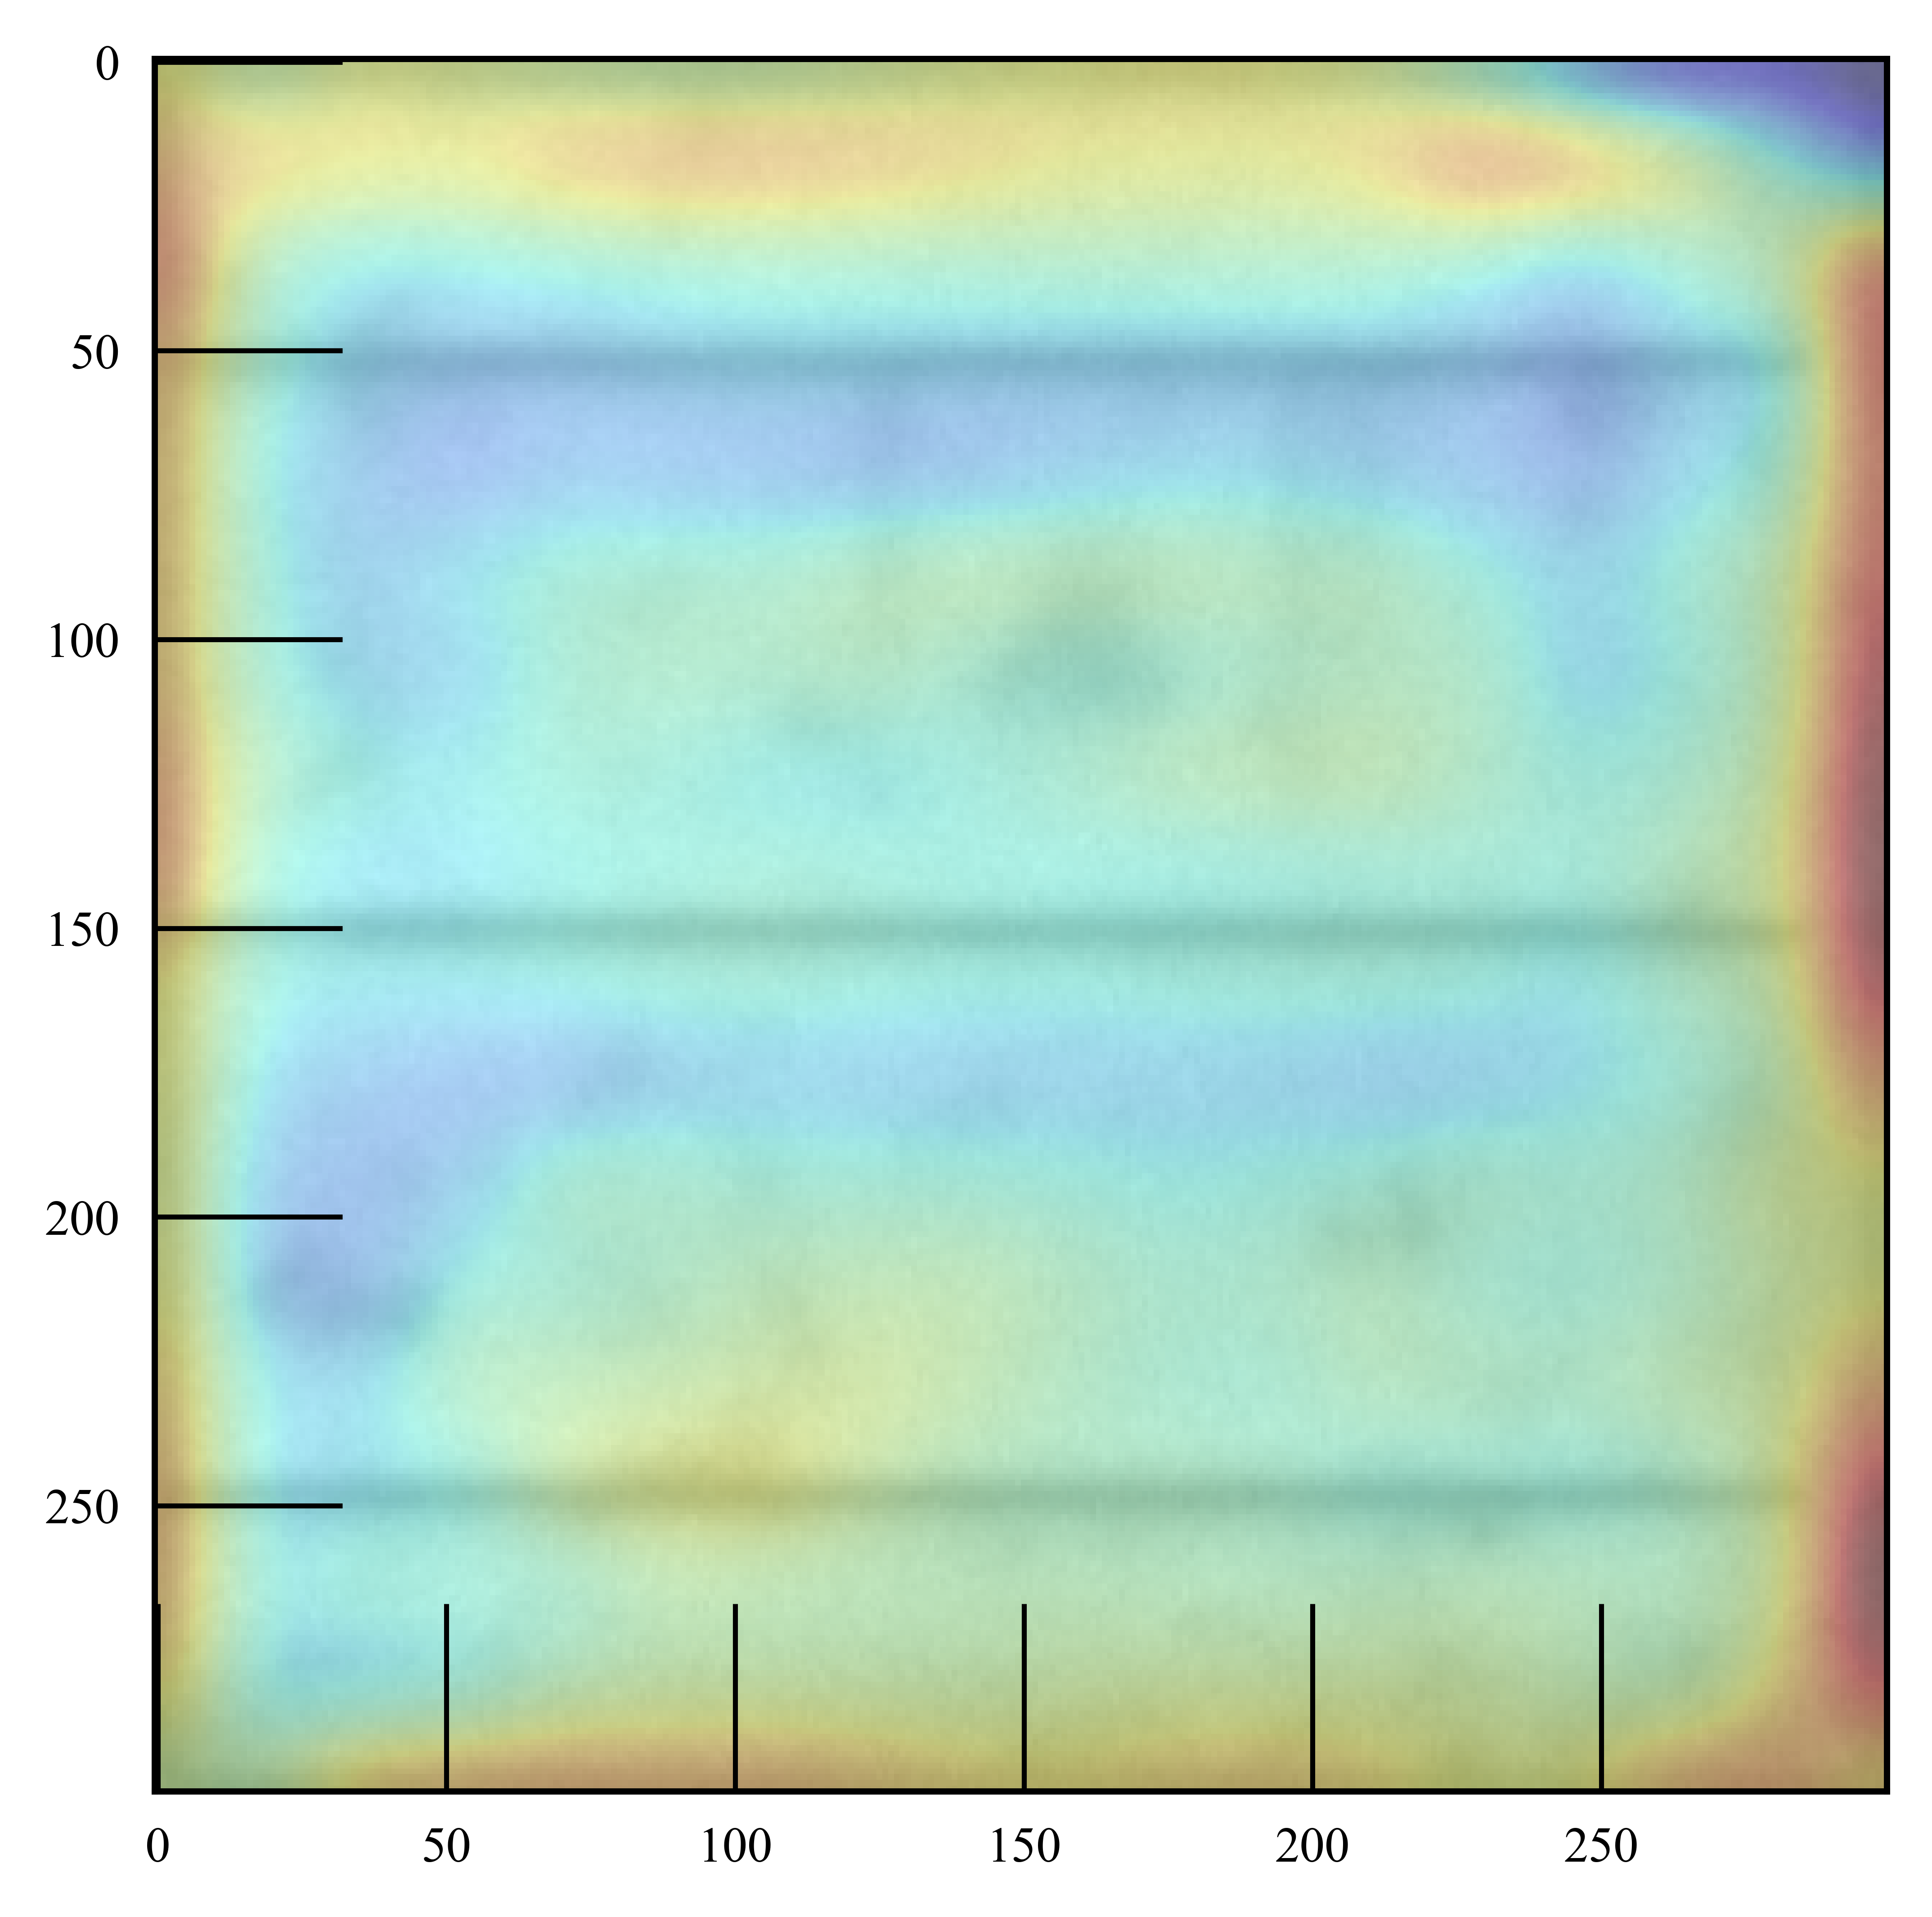
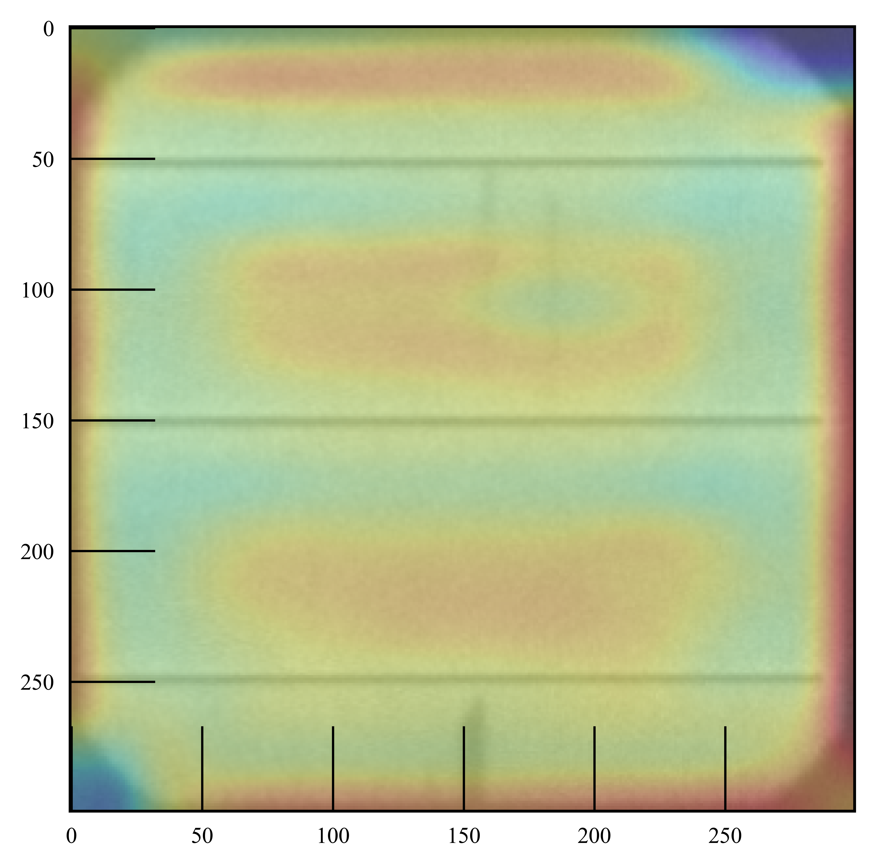
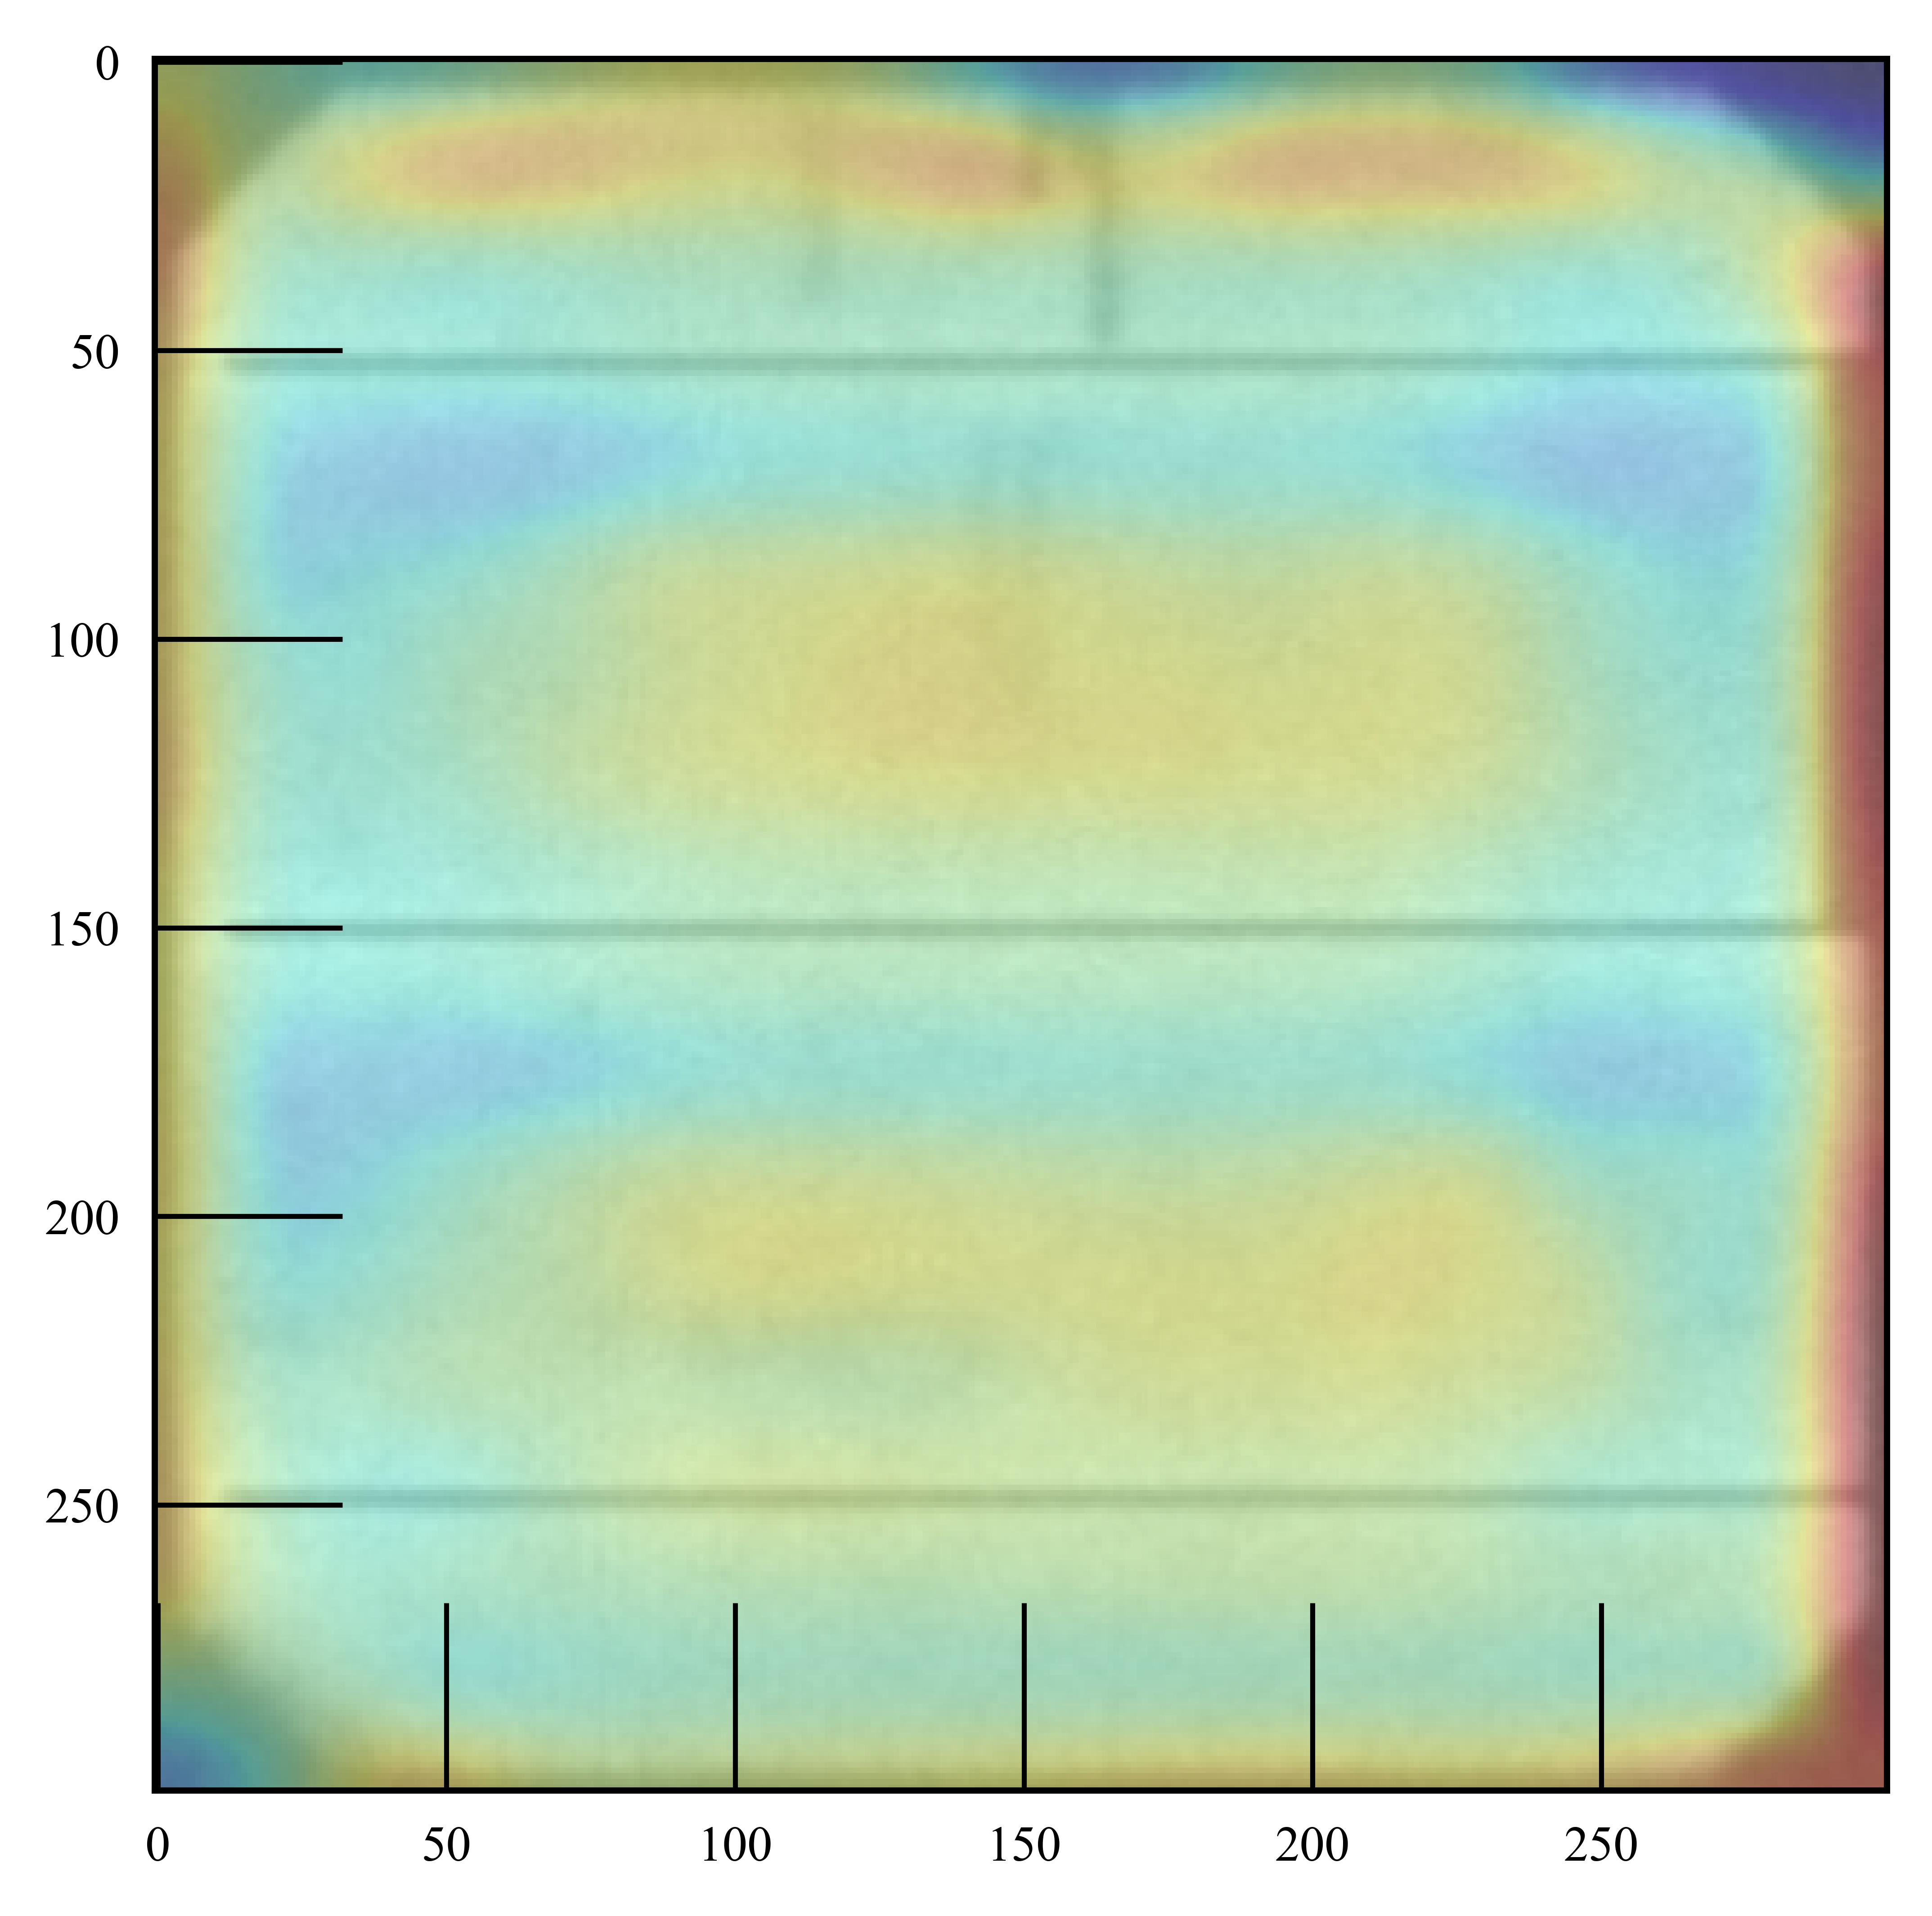
Polycrystalline
Actual Class: 0.0
Actual Class: 0.0
Actual Class: 0.0
Actual Class: 0.0
Actual Class: 0.0
Predicted Class: 0.0
Predicted Class: 0.0
Predicted Class: 0.0
Predicted Class: 0.0
Predicted Class: 0.0
Actual Class: 1.0
Actual Class: 1.0
Actual Class: 1.0
Actual Class: 1.0
Actual Class: 1.0
Predicted Class: 0.0
Predicted Class: 1.0
Predicted Class: 0.0
Predicted Class: 1.0
Predicted Class: 1.0
Monocrystalline
Actual Class: 0.0
Actual Class: 0.0
Actual Class: 0.0
Actual Class: 0.0
Actual Class: 0.0
Predicted Class: 0.0
Predicted Class: 0.0
Predicted Class: 0.0
Predicted Class: 0.0
Predicted Class: 0.0
Actual Class: 0.0
Actual Class: 0.0
Actual Class: 1.0
Actual Class: 1.0
Actual Class: 1.0
Predicted Class: 0.0
Predicted Class: 0.0
Predicted Class: 1.0
Predicted Class: 1.0
Predicted Class: 0.0

Slide 10
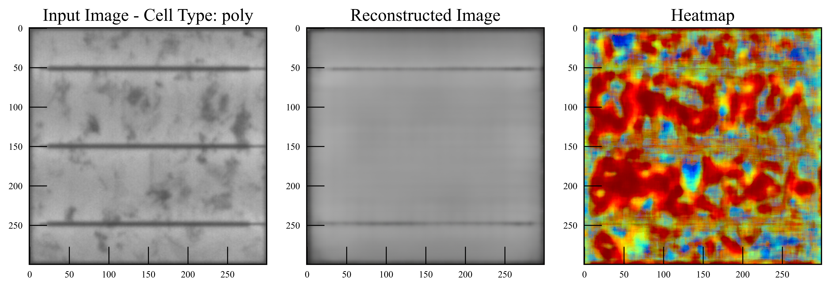
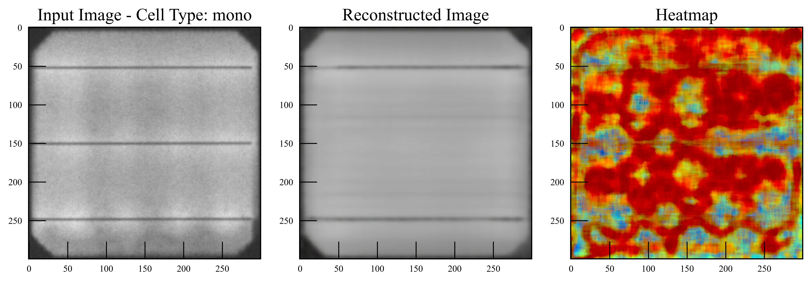
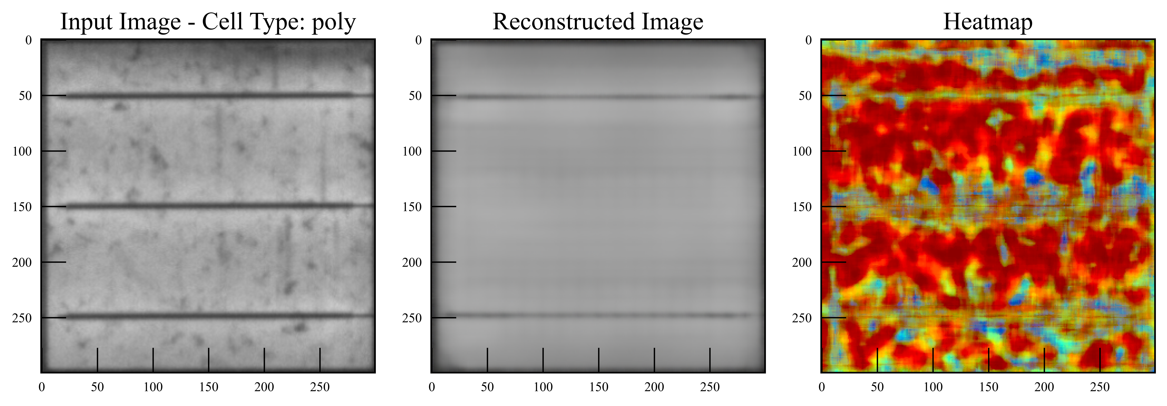
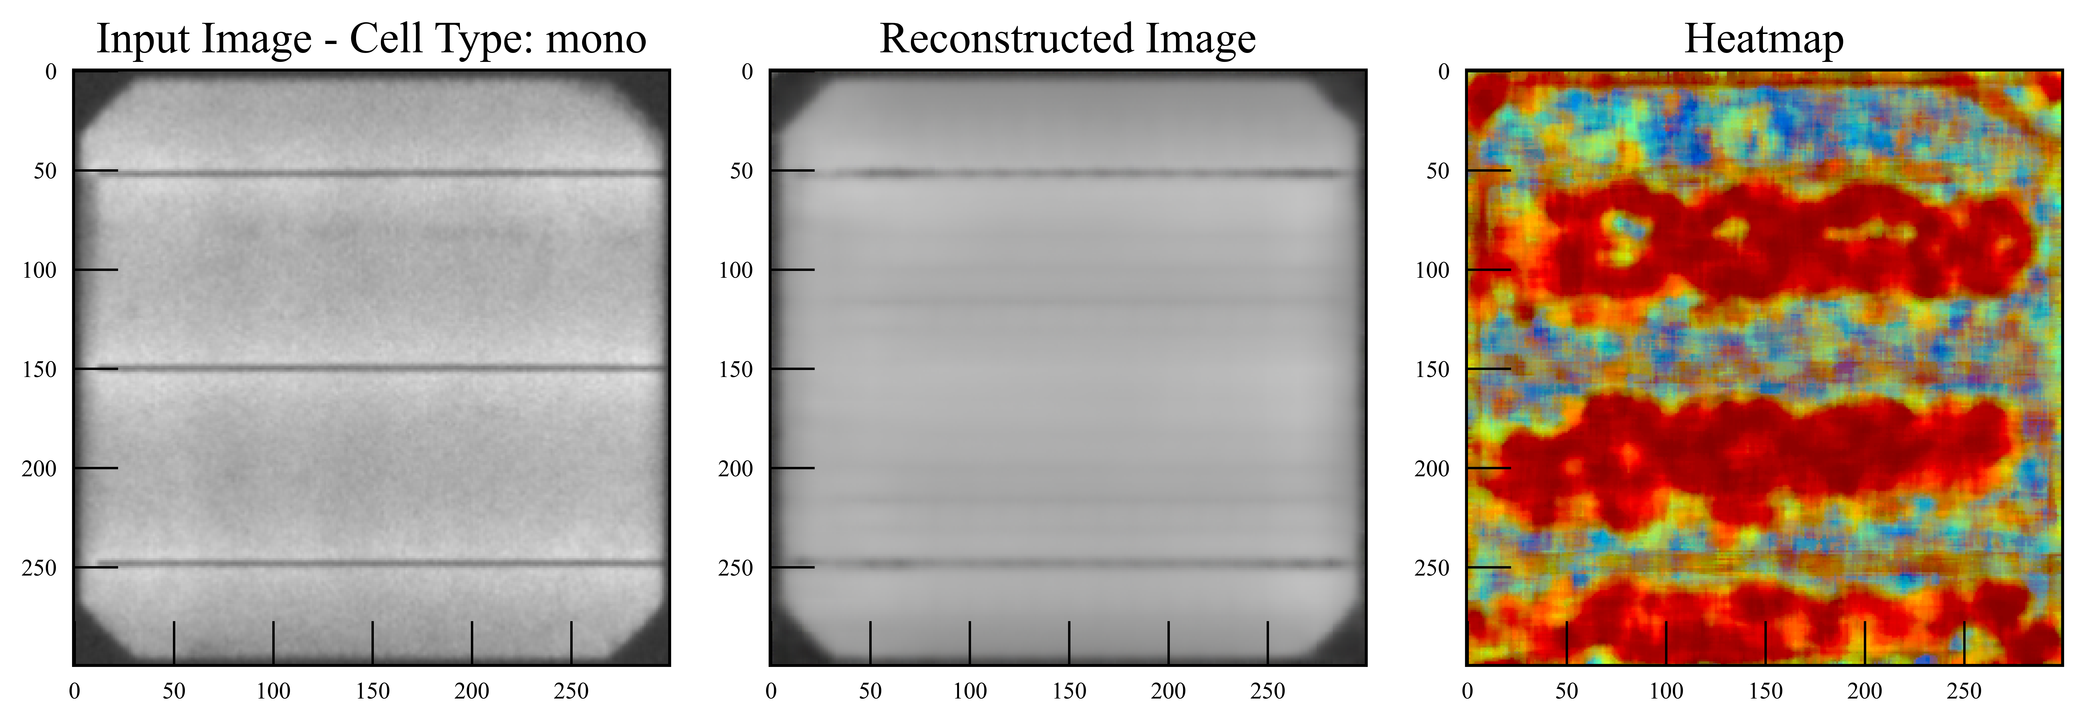
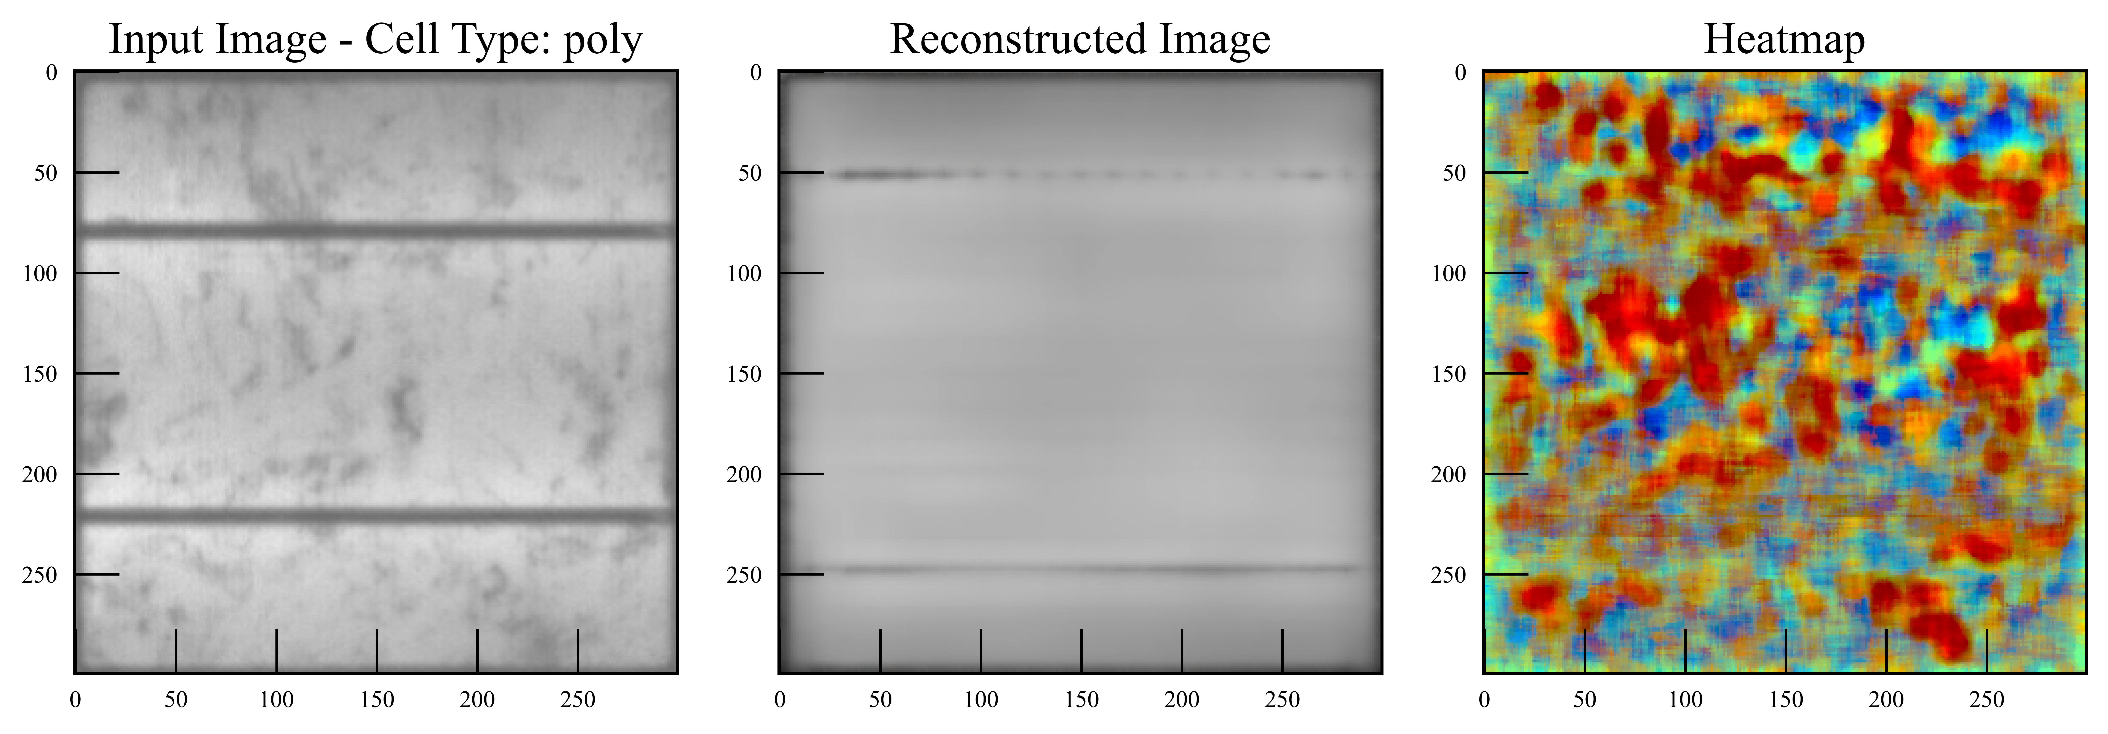
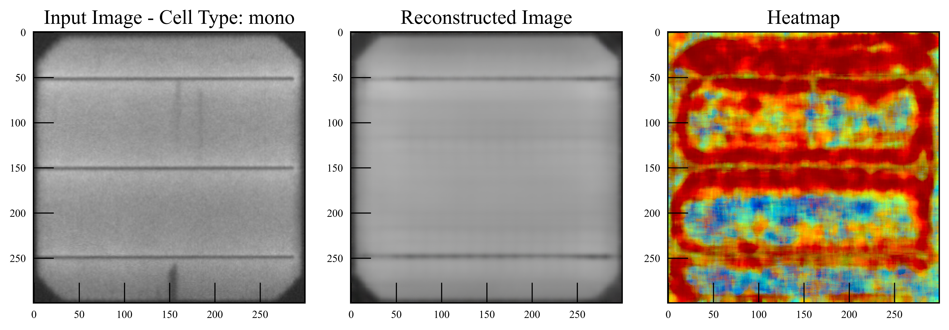
Actual Class: 0.0
DSSIM Score: 0.2246
Actual Class: 0.0
DSSIM Score: 0.1386
Actual Class: 1.0
DSSIM Score: 0.2233
Actual Class: 0.0
DSSIM Score: 0.1311
Actual Class: 0.0
DSSIM Score: 0.2413
Actual Class: 1.0
DSSIM Score: 0.1003

Slide 11
Validation Metric | Seed 1 | Seed 2 | Seed 3 | Seed 4 | Seed 5
Mean accuracy | 0.6427 | 0.5990 | 0.6952 | 0.6758 | 0.6291
Mean precision | 0.5855 | 0.6652 | 0.6938 | 0.6707 | 0.5610
Mean recall | 0.6742 | 0.5716 | 0.6366 | 0.5810 | 0.7367

Slide 12
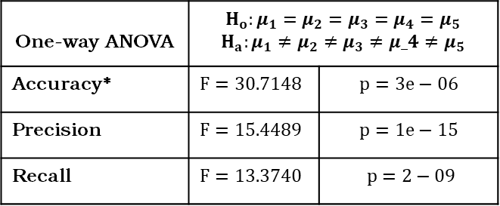
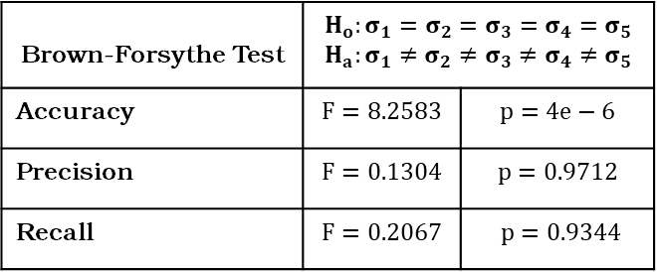
Brown-Forsythe Test | $$H_{o}:σ_{1}=σ_{2}=σ_{3}=σ_{4}=σ_{5}$$ $$H_{a}:σ_{1}≠σ_{2}≠σ_{3}≠σ_{4}≠σ_{5}$$
Accuracy | $$F=8.2583$$ | $$p=4e−6$$
Precision | $$F=0.1304$$ | $$p=0.9712$$
Recall | $$F=0.2067$$ | $$p=0.9344$$
One-way ANOVA | $$H_{o}:μ_{1}=μ_{2}=μ_{3}=μ_{4}=μ_{5}$$ $$H_{a}:μ_{1}≠μ_{2}≠μ_{3}≠μ_4≠μ_{5}$$
Accuracy* | $$F=30.7148$$ | $$p=3e−06$$
Precision | $$F=15.4489$$ | $$p=1e−15$$
Recall | $$F=13.3740$$ | $$p=2−09$$

